Slide 1
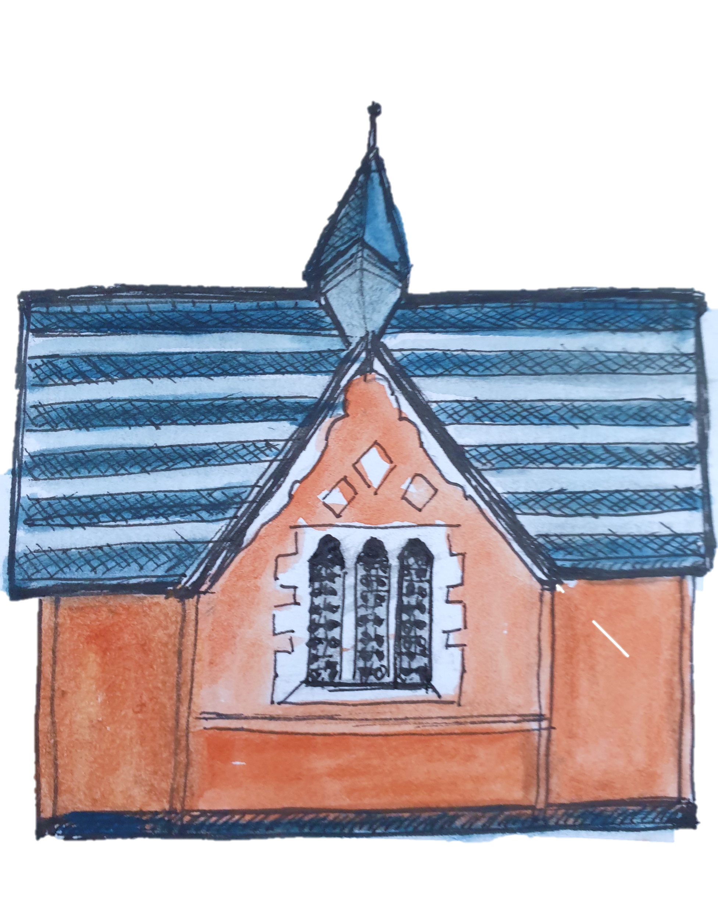
Wick History Detectives
SESSION 2

Slide 2
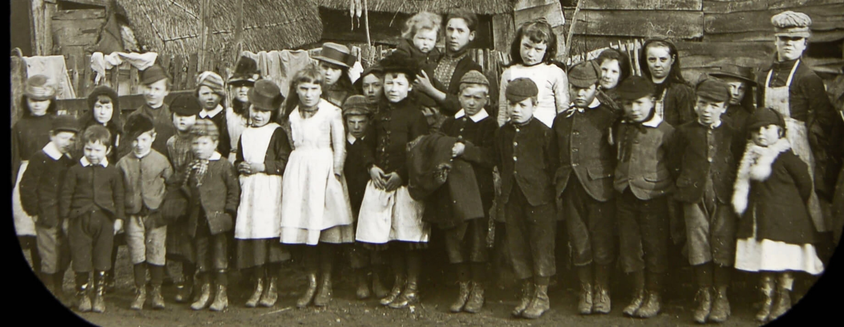
SESSION TWO
THE HOUSES AND PEOPLE IN WICK
Do you remember this photograph from Session One? We are now going
To find out about their families and where they might have lived.

Slide 3
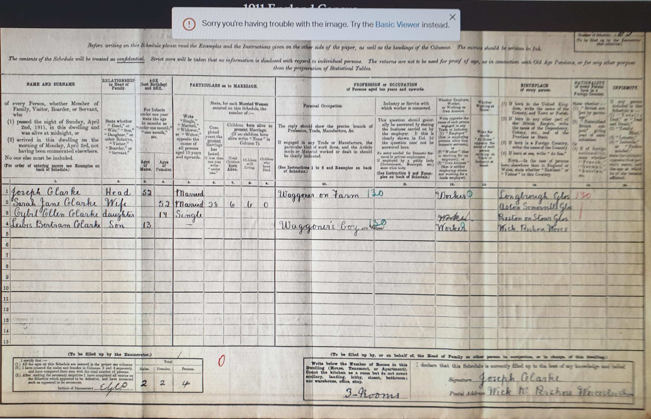
This is one of the census forms from 1911. Can you read it? Have a go.
WE CAN TRY AND FIND OUT WHERE THESE CHILDREN LIVED IN THE VILLAGE OF WICK BY LOOKING AT THE CENSUS FORMS FOR 1911.

Slide 4
WHAT IS A CENSUS? A census was an official list made every 10 years of all the people living in every house in a village or town in England. You and your family would have been on the Census for 2021
WE WILL BE LOOKING AT OLD PHOTOGRAPHS
OF THE HOUSES AND COTTAGES IN WICK VILLAGE
SO WE CAN FIND OUT ABOUT THE FAMILIES WHO LIVED IN THEM FROM THE OLD CENSUS DOCUMENTS.

Slide 5
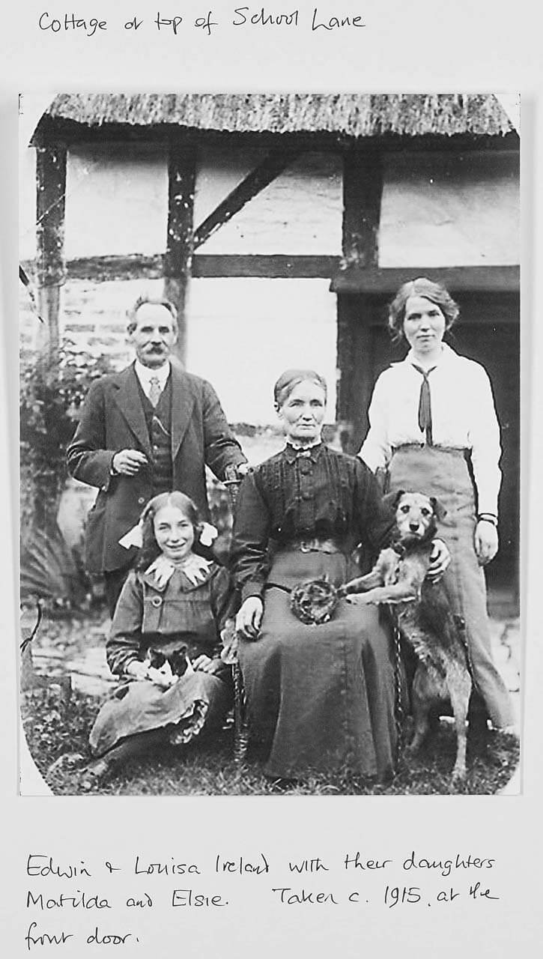
This photo shows a family who lived on School Lane. Below is a transcription of their entry in the 1911 Census.
CENSUS 1911
Record No. | NAME | Status | Age | M/S/W | Occupation | Birthplace | Rooms | House/ Notes
86 | IRELAND
 | Edwin | Head | 56 | M 33 yrs | Gardeners labourer | Glos | 8 rooms
 | Louisa | Wife | 55 | M 33 yrs |  | Charlton
 | Robert | Son | 20 | Single | Gardeners labourer | WICK
 | Thomas | Son | 16 | Single | Gardeners labourer | WICK
 | Doris | Daughter | 12 |  | Scholar | WICK
 | Matilda | Daughter | 9 |  |  | WICK
Matilda was only 9 years old when the 1911 Census was made and Elsie had not been born yet! In this photograph Matilda would have been about 14 and Elsie about 4 or 5 years old. The older boys would have left home and be working by then.

Slide 6
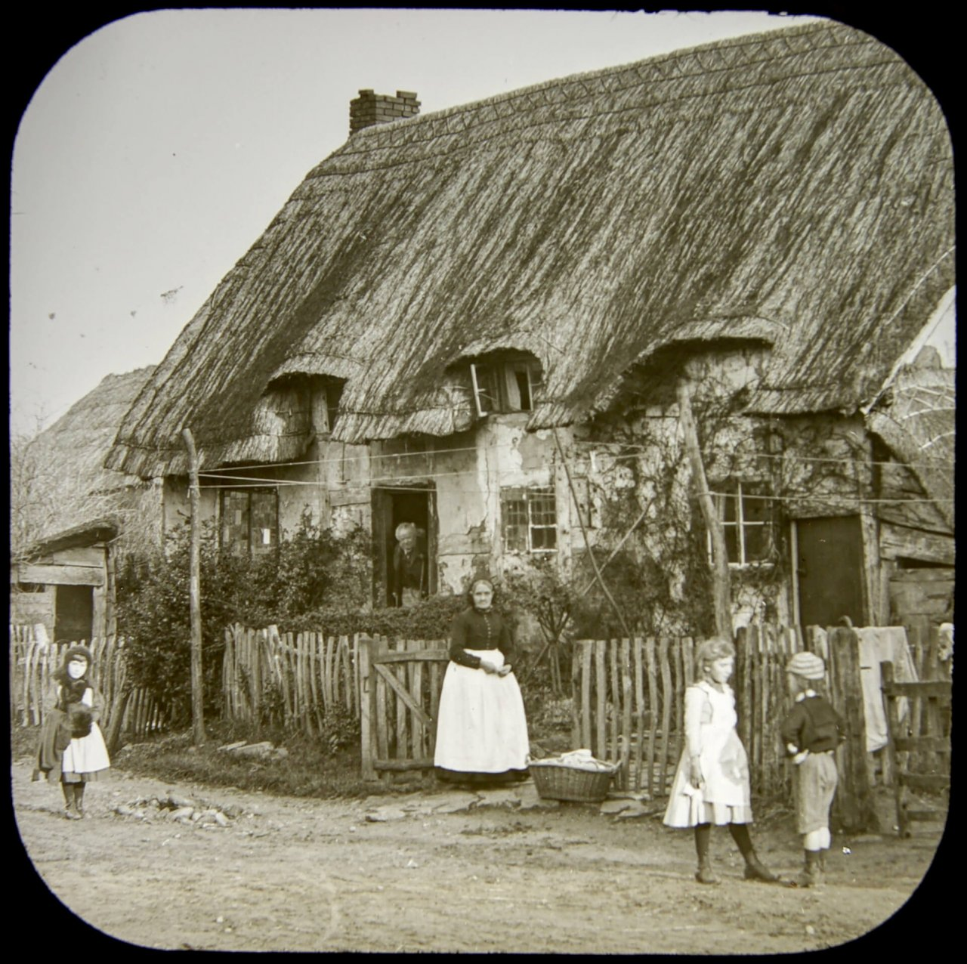
JOBS AND OCCUPATIONS
We will also find out what jobs or occupations the villagers had.
Notice Mrs Betsey Hall’s basket of washing and the white pinafores and aprons. Women often took in dirty washing for other people or worked as laundresses in the big houses.
Do you know what day of the week was traditionally ‘Wash Day’?
See next slide for answer.
Betsey Hall’s Cottage
Notes:
Go to next slide for answer. Then follow the link if you would like further information.

Slide 7
Washday – was always Monday
Washday was once a week. It was easier to do it on one single day. It was always on a Monday, and it took the whole day, starting between five and six o'clock in the morning. There was no time to prepare meals. That was why washday was always on a Monday, because the meals could be cold leftovers from the Sunday roast. Everyone did their washing on Monday.
Extract taken form an excellent website about domestic life in the early 20th century. With kind permission of the webmaster.
Notes:
For more information on this topic visit website section on washing.
http//www.1900s.org.uk/1900s-washdays.htm
Monday washdays: the weekly wash/laundry before electric appliances
Monday washdays: the weekly wash/laundry before electric appliances

Slide 8
AFTER THIS SESSION
YOU WILL BE GIVEN A FOLDER WITH
A PHOTOGRAPH AND INFORMATION ABOUT ONE OF THE
VILLAGE HOUSES AND A CENSUS FROM THE YEAR 1911
FOR YOU TO FIND OUT WHO LIVED IN YOUR HOUSE.
SO LET US BEGIN OUR INVESTIGATION WITH AN INTRODUCTION TO SOME OF THE HOUSES AND COTTAGES IN WICK
Starting with the biggest and most important
house belonging to the lord of the manor.

Slide 9
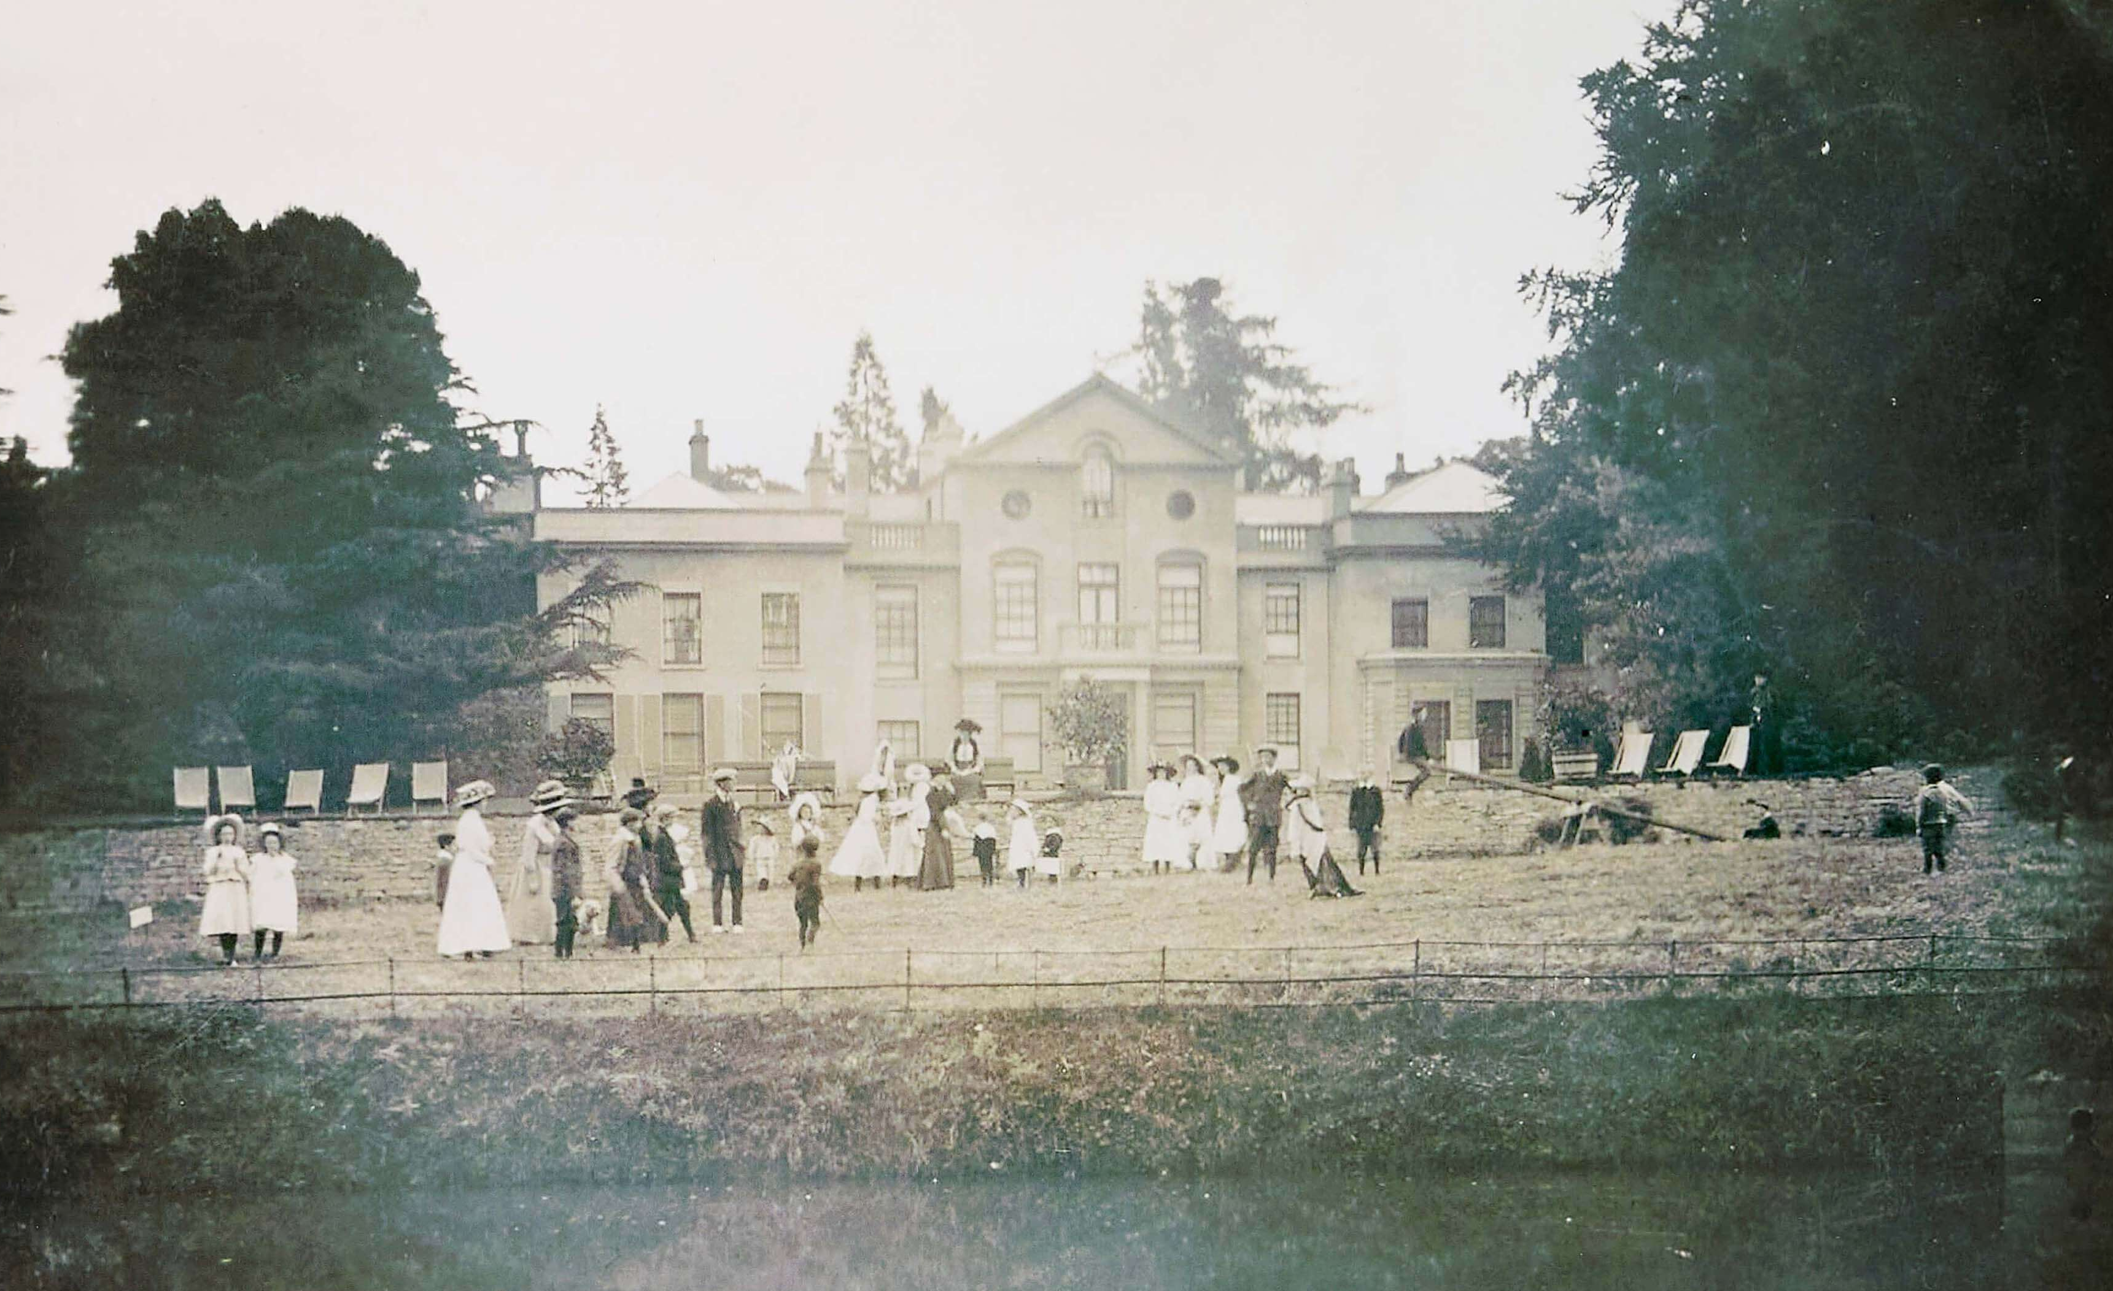
Wick House
House Folder No: 1
WICK HOUSE
The largest and grandest
mansion house in the village,
owned and lived in by the
Hudson family. The photograph
was taken in 1910. Sadly, this
lovely house burnt down in
the 1960s and was never rebuilt.
Parts of the lake can still be seen
on the edge of the village.

Slide 10
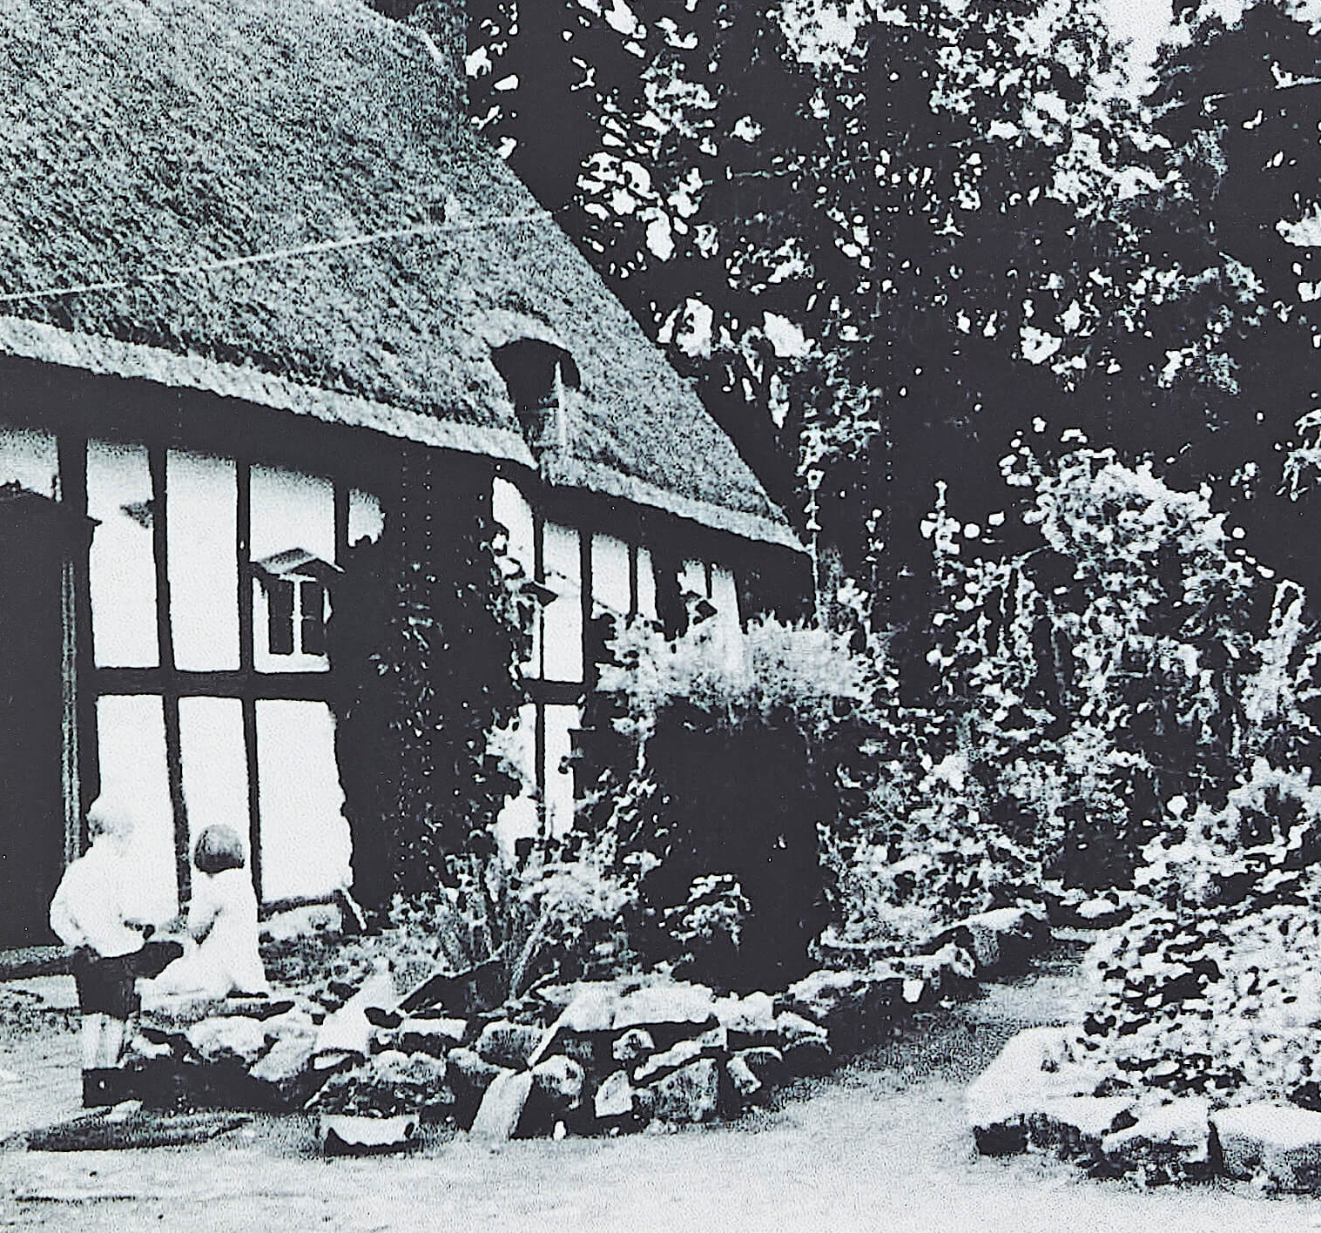
Wayland Cottage
House Folder No: 2
WAYLAND COTTAGE
This cottage was a lovely example of a thatched roof with walls of box timber-framing (square shaped frame). It was very old and has now been replaced with a new house.
A little bedroom window is poking out of the roof. Do you think the children slept up there? Can you imagine what
it was like inside the room?
Notes:
Most bedrooms were in the roof space but this room was maybe used for the children. It would have been dark but cosy.

Slide 11
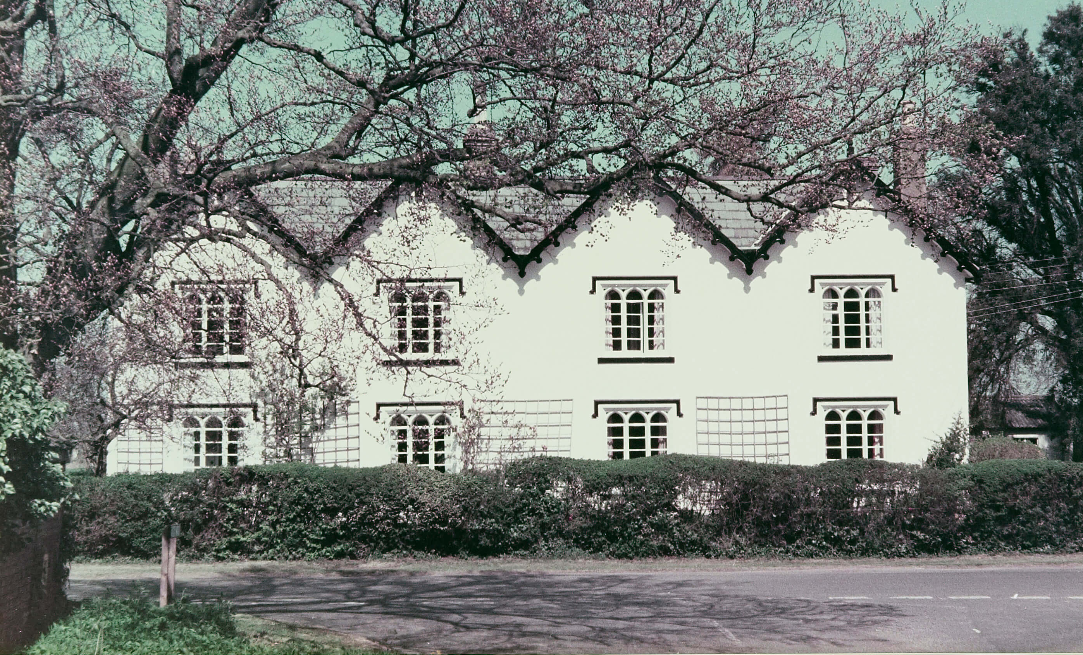
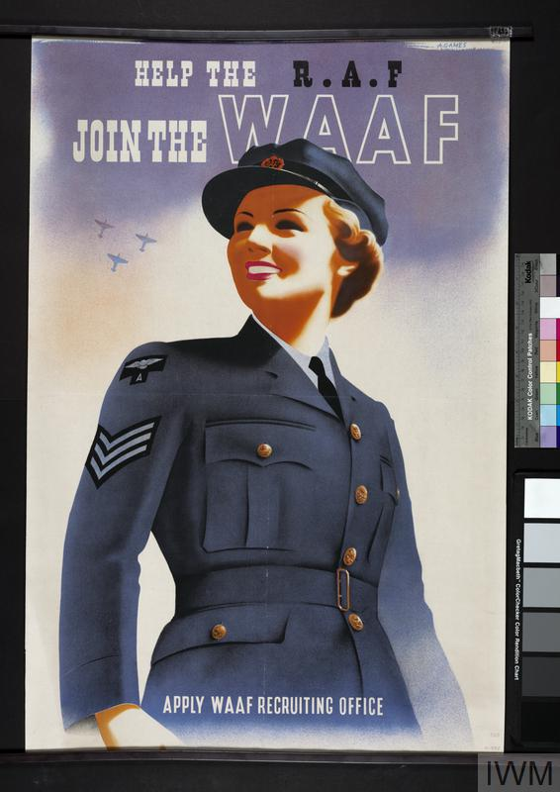
Vandyke Court
House Folder No: 3
VANDYKE COURT
A fine Victorian house.
During World War II the
area behind this house
Was used as barracks for
The Women’s Royal
Auxiliary Air Force (WAAFs),
who worked at the Radar
Station in Wick.
Do you know what barracks are used for?
Notes:
Barracks were where the women would have slept. There would have been several beds all in a row with a cupboard each for their clothes and things like hairbrushes, soap, toothbrush and toothpaste. See the Wick History Website for more information about RAF Comberton located on the edge of the village of Wick.

Slide 12
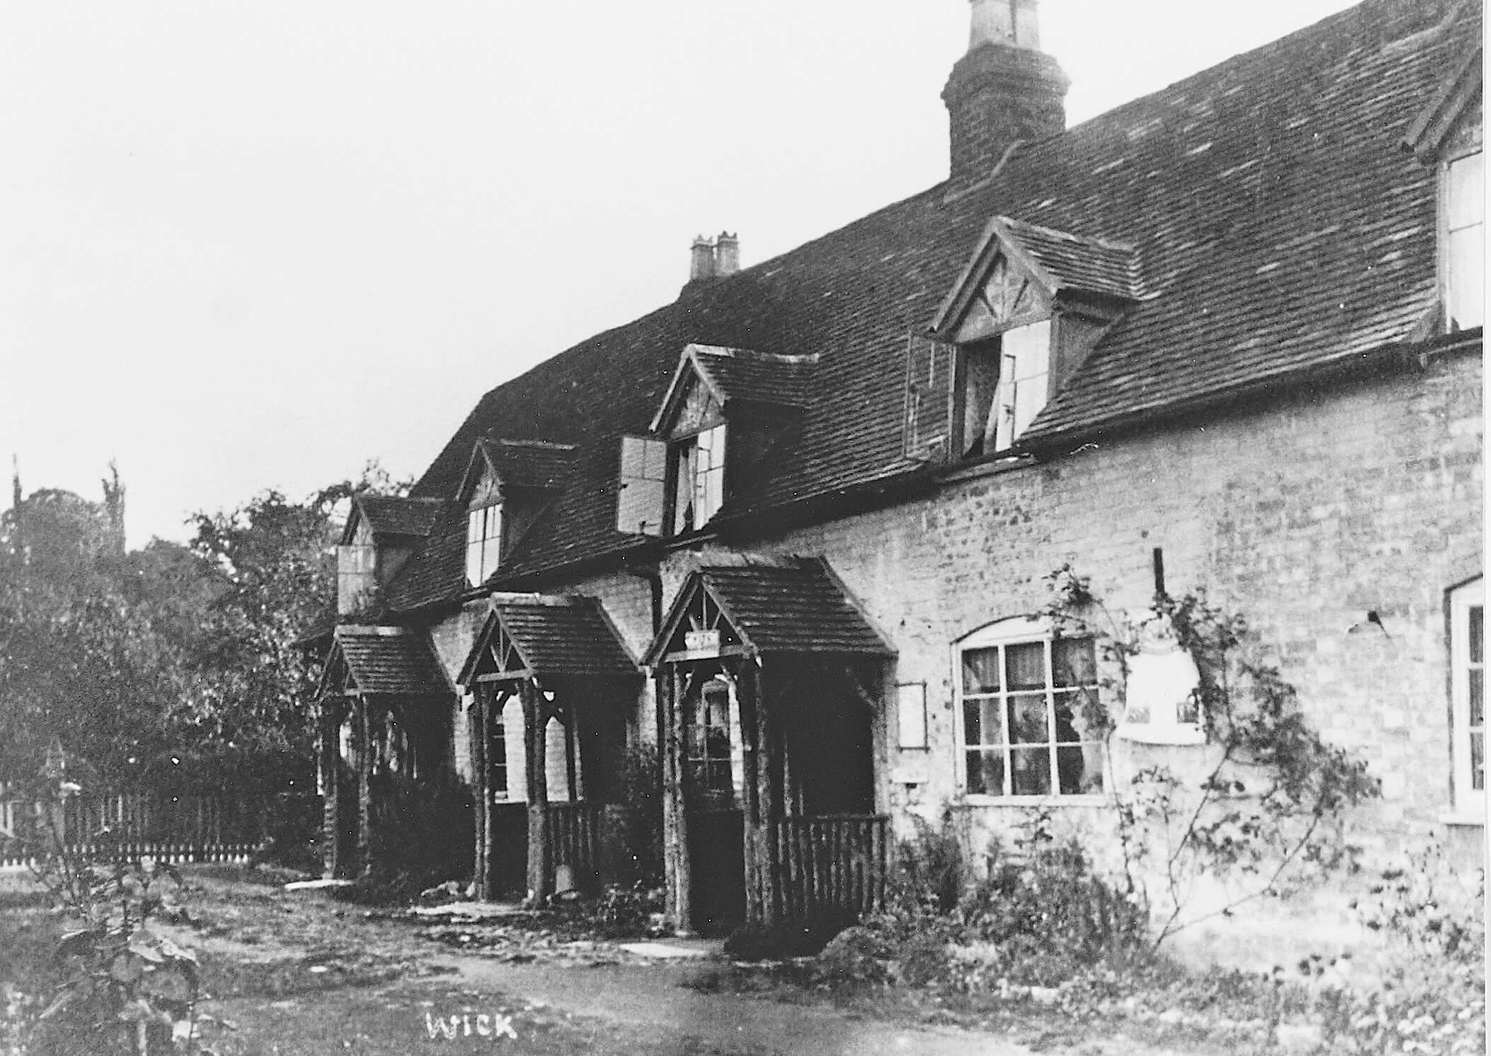
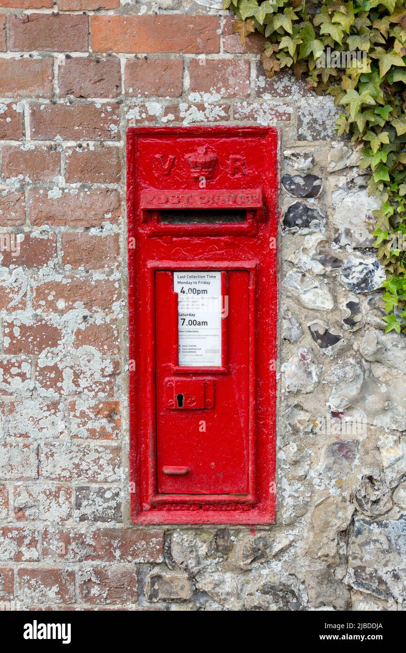
Ruyhalls Cottages Nos 1, 2 and 3
House Folder No:4
RUYHALLS COTTAGES
This photograph was taken
about 1900. It looks much the
same now but tidier and nicer!
The end cottage was used as
a Sub Post Office at this time.
Can you see the old
Post Box on the cottage
wall? It would have been
red, like this one.
In earlier Victorian times Postmen were called Red Robins – why was that?
Notes:
Postmen wore red jackets during the earlier Victorian period so they would stand out. They later became dark blue with a red collar and this is what the post man woud have worn at the time of this photograph about 1900.

Slide 13
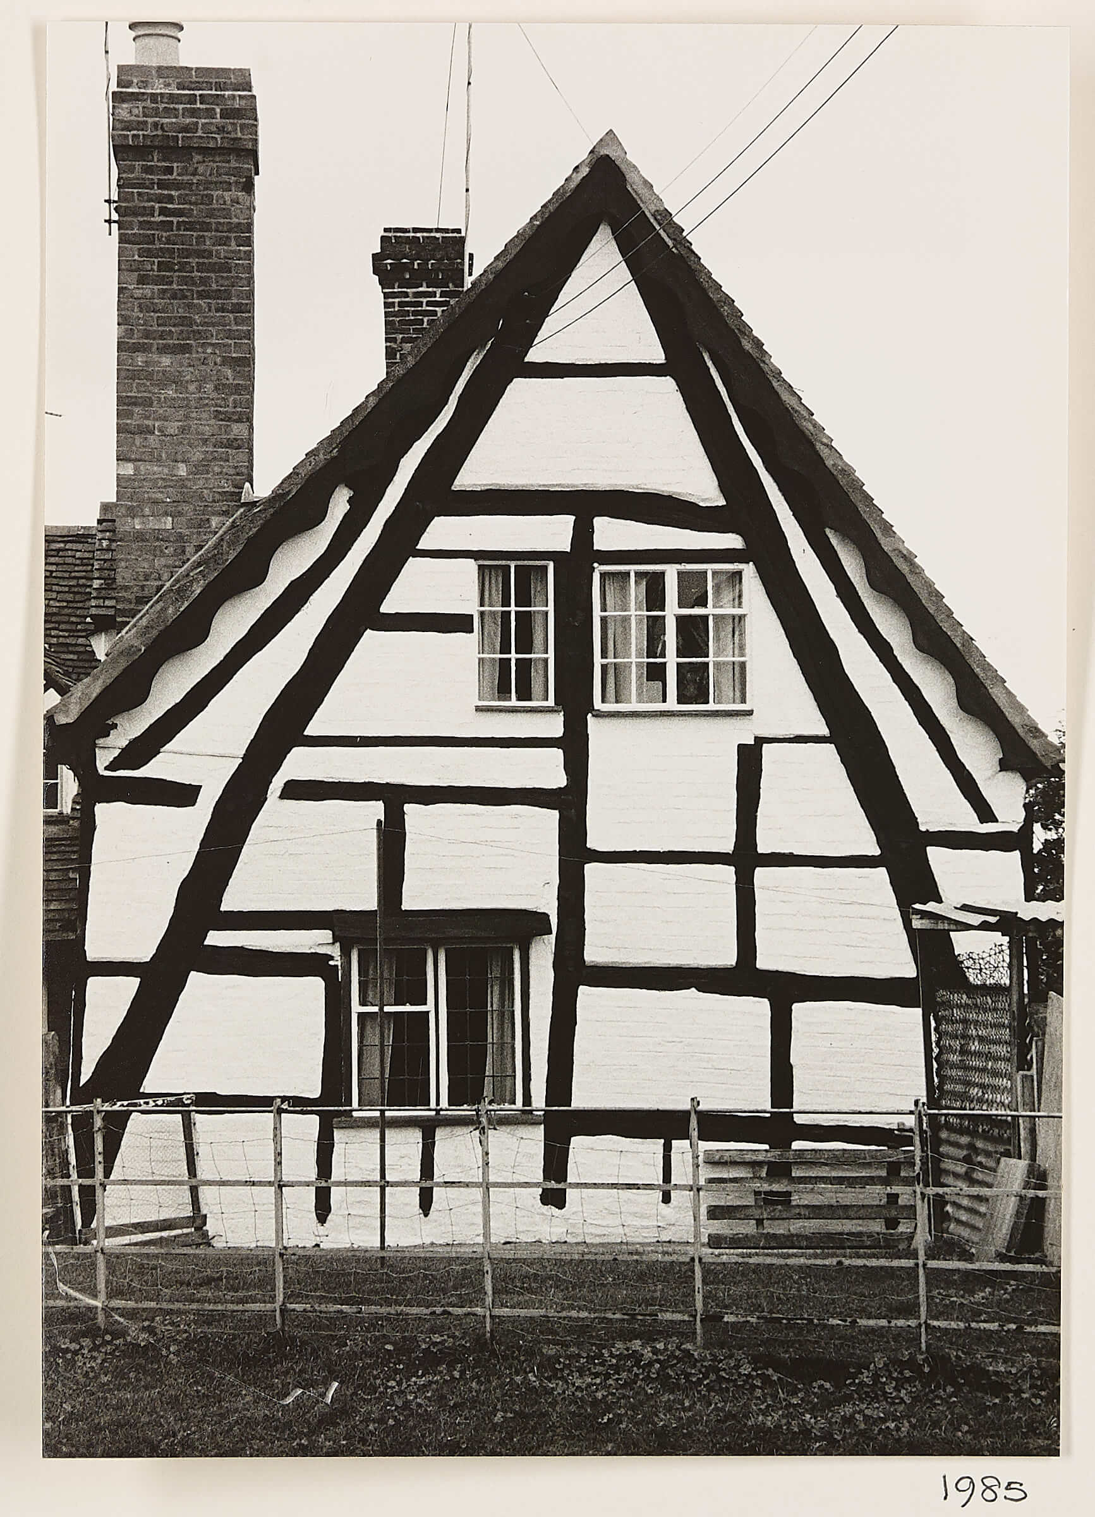
The Cruck House
House Folder No: 5
THE CRUCK HOUSE
This very old house was built in a different way to the later box frame, it was called
a cruck frame. It looks like a letter ‘A’.
How do you think a wooden cruck frame
was made? See if you can find out.
Look on next slide to see the names of all
the pieces of wood in a cruck structure.
Notes:
Cruck frames were made by splitting one large tree trunk in half and opening it out to make an upside ‘V’ shape – this would then be braced by putting beams across it making it strong and looking like an ‘A’ shape. Trees were specially selected or even grown with a bend at the top so help make these cruck timbers.

Slide 14
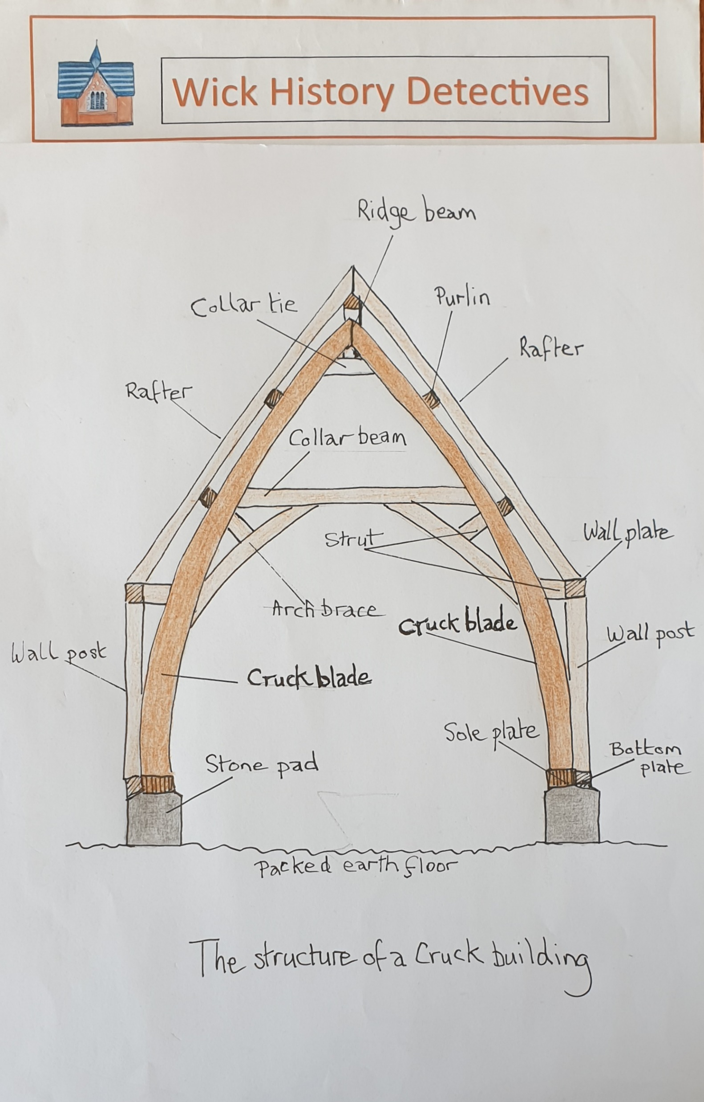
Can you identify and name the different wooden timbers on the Cruck House?
Notes:
Copy of this also in Teachers Notes.

Slide 15
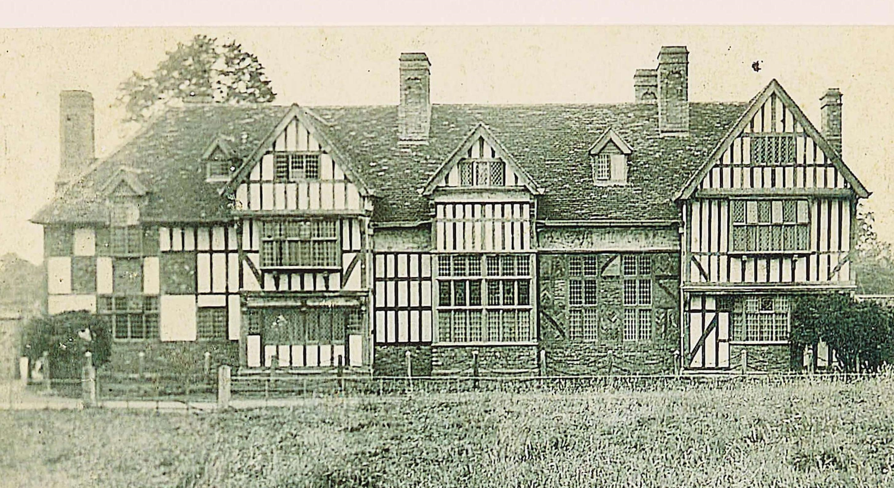
Upper Wick House (later known as Wick Manor)
House Folder No: 6
WICK MANOR
This fine mansion house
belongs to the Hudson
family, who rebuilt it in
the 1920s in this lovely
Arts and Crafts style.
The house has its own
chapel.
The Hudson family still continue to live in the house and farm in the village.

Slide 16
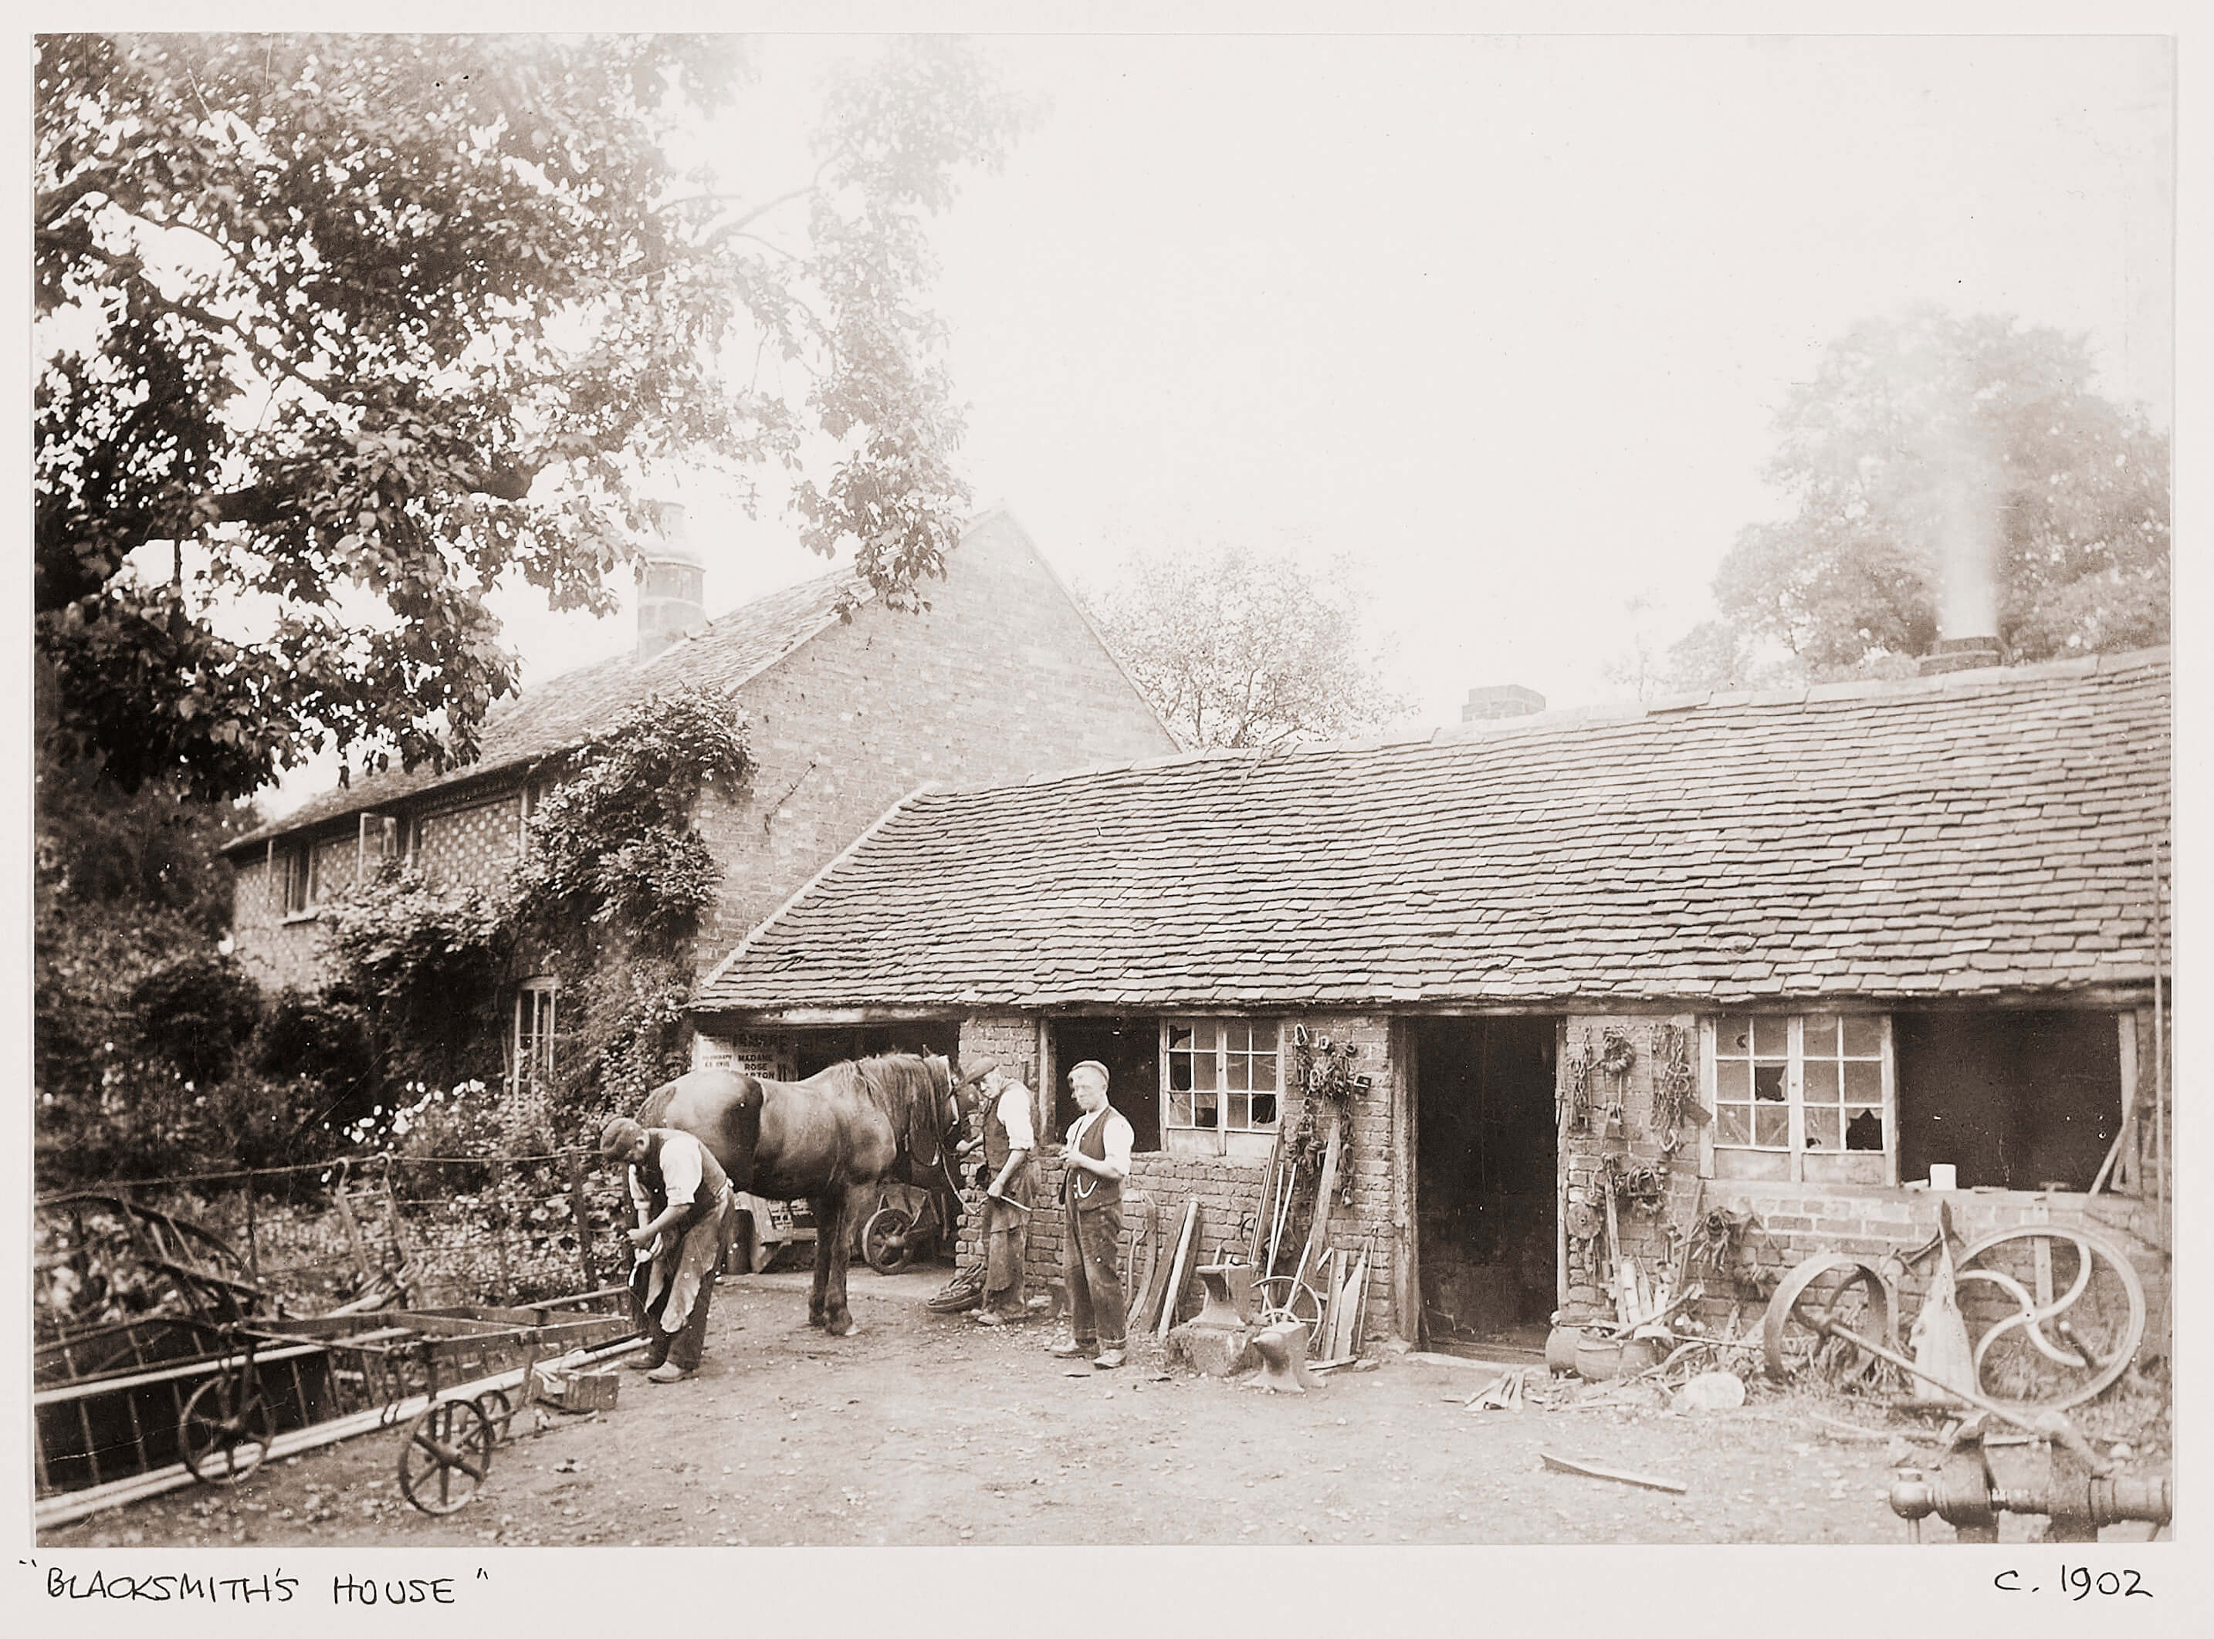
Forge Cottage and The Forge
House Folder No: 7
FORGE COTTAGE
The Sherwood family were
blacksmiths and farriers for
a 100 years in Wick. Making
tools and equipment for
the villagers. The job was
passed on from father to
son, who learnt the many
skills for working with metals.
Can you find out what a farrier did? The answer is on the next slide.
Notes:
A farrier was a blacksmith who specialised in shoeing horses. A farrier had to keep the horse calm and be quick and efficient and know how to trim the hooves first.

Slide 17
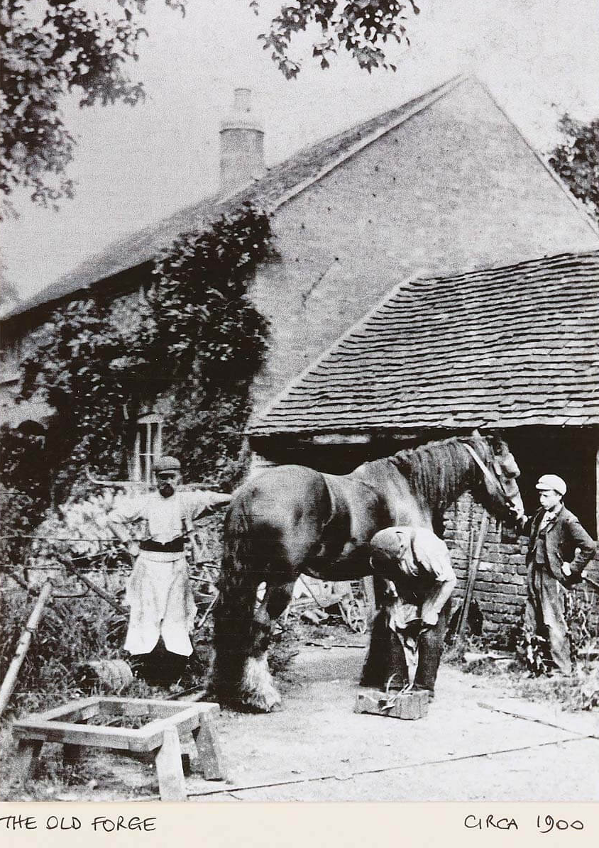
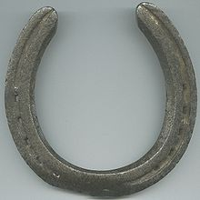
The farrier put iron shoes on horses and donkeys.
An iron horseshoe. This was attached to the horse’s hoof using special nails.
It did not hurt the horse.
Here is Mr Sherwood shoeing a cart horse.

Slide 18
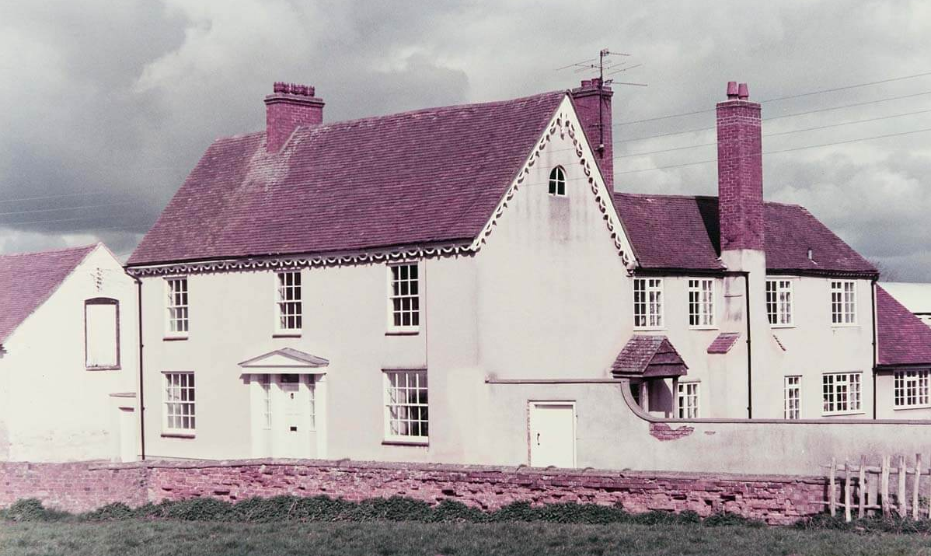
Glenmore Farm
House Folder No. 8
GLENMORE FARM
This photograph shows a
farmhouse that looks
18th century but inside
there is a medieval hall,
possibly 300 years older!
The oldest timber-framed
walls were filled with wattle
and daub.
Can find out what wattle and daub was made of?
Notes:
Wattle and daub is made from a mixture of mud, straw and animal manure (yes, poo!) was pushed into the panels between the frame which was woven with sticks.

Slide 19
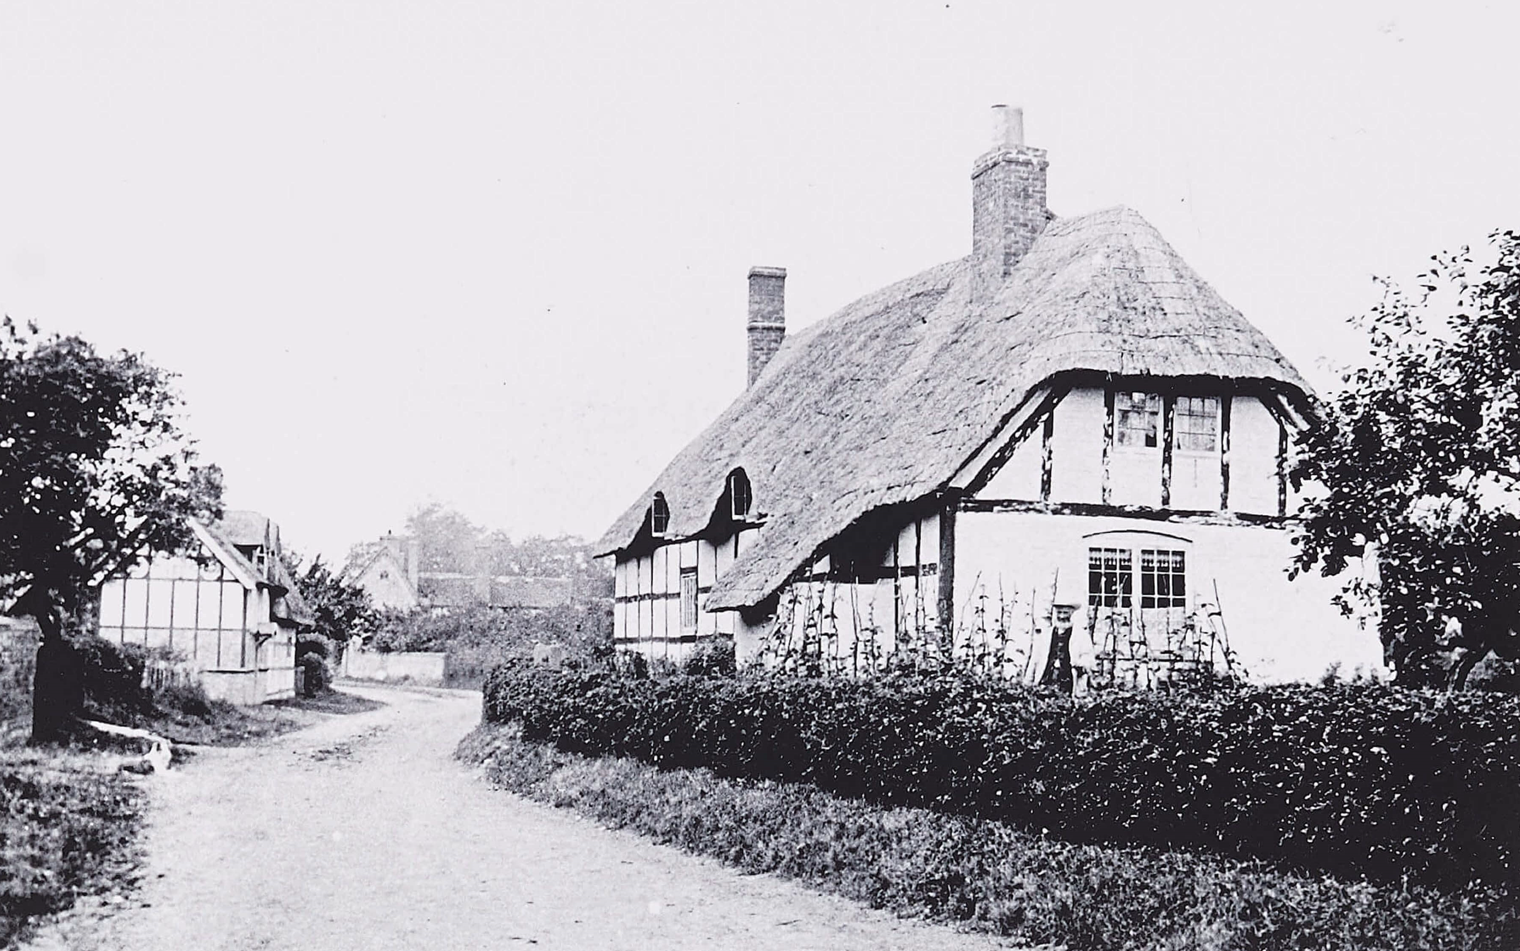
Glenmore Cottage
House Folder No. 9
GLENMORE COTTAGE
Another lovely thatched cottage
and it is still there and looks
much the same. Notice the
thatched roof hanging over the
windows – they look like eye-brows!
Why do you think thatchers did that?
And what sort of materials were used to thatch the roofs of cottages?
The next slide shows some of the tools they used.
Notes:
A thatcher had to make sure the rain did not run down the windows and cause a leak.
They used straw and reeds to thatch houses and often had to do the ridge several times to keep the rain out. Straw was the most common material used in this area. It was grown especially long for that purpose.

Slide 20
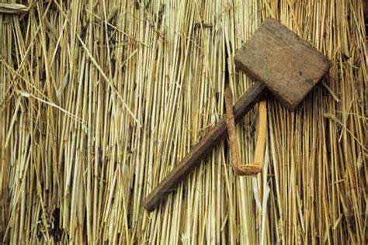
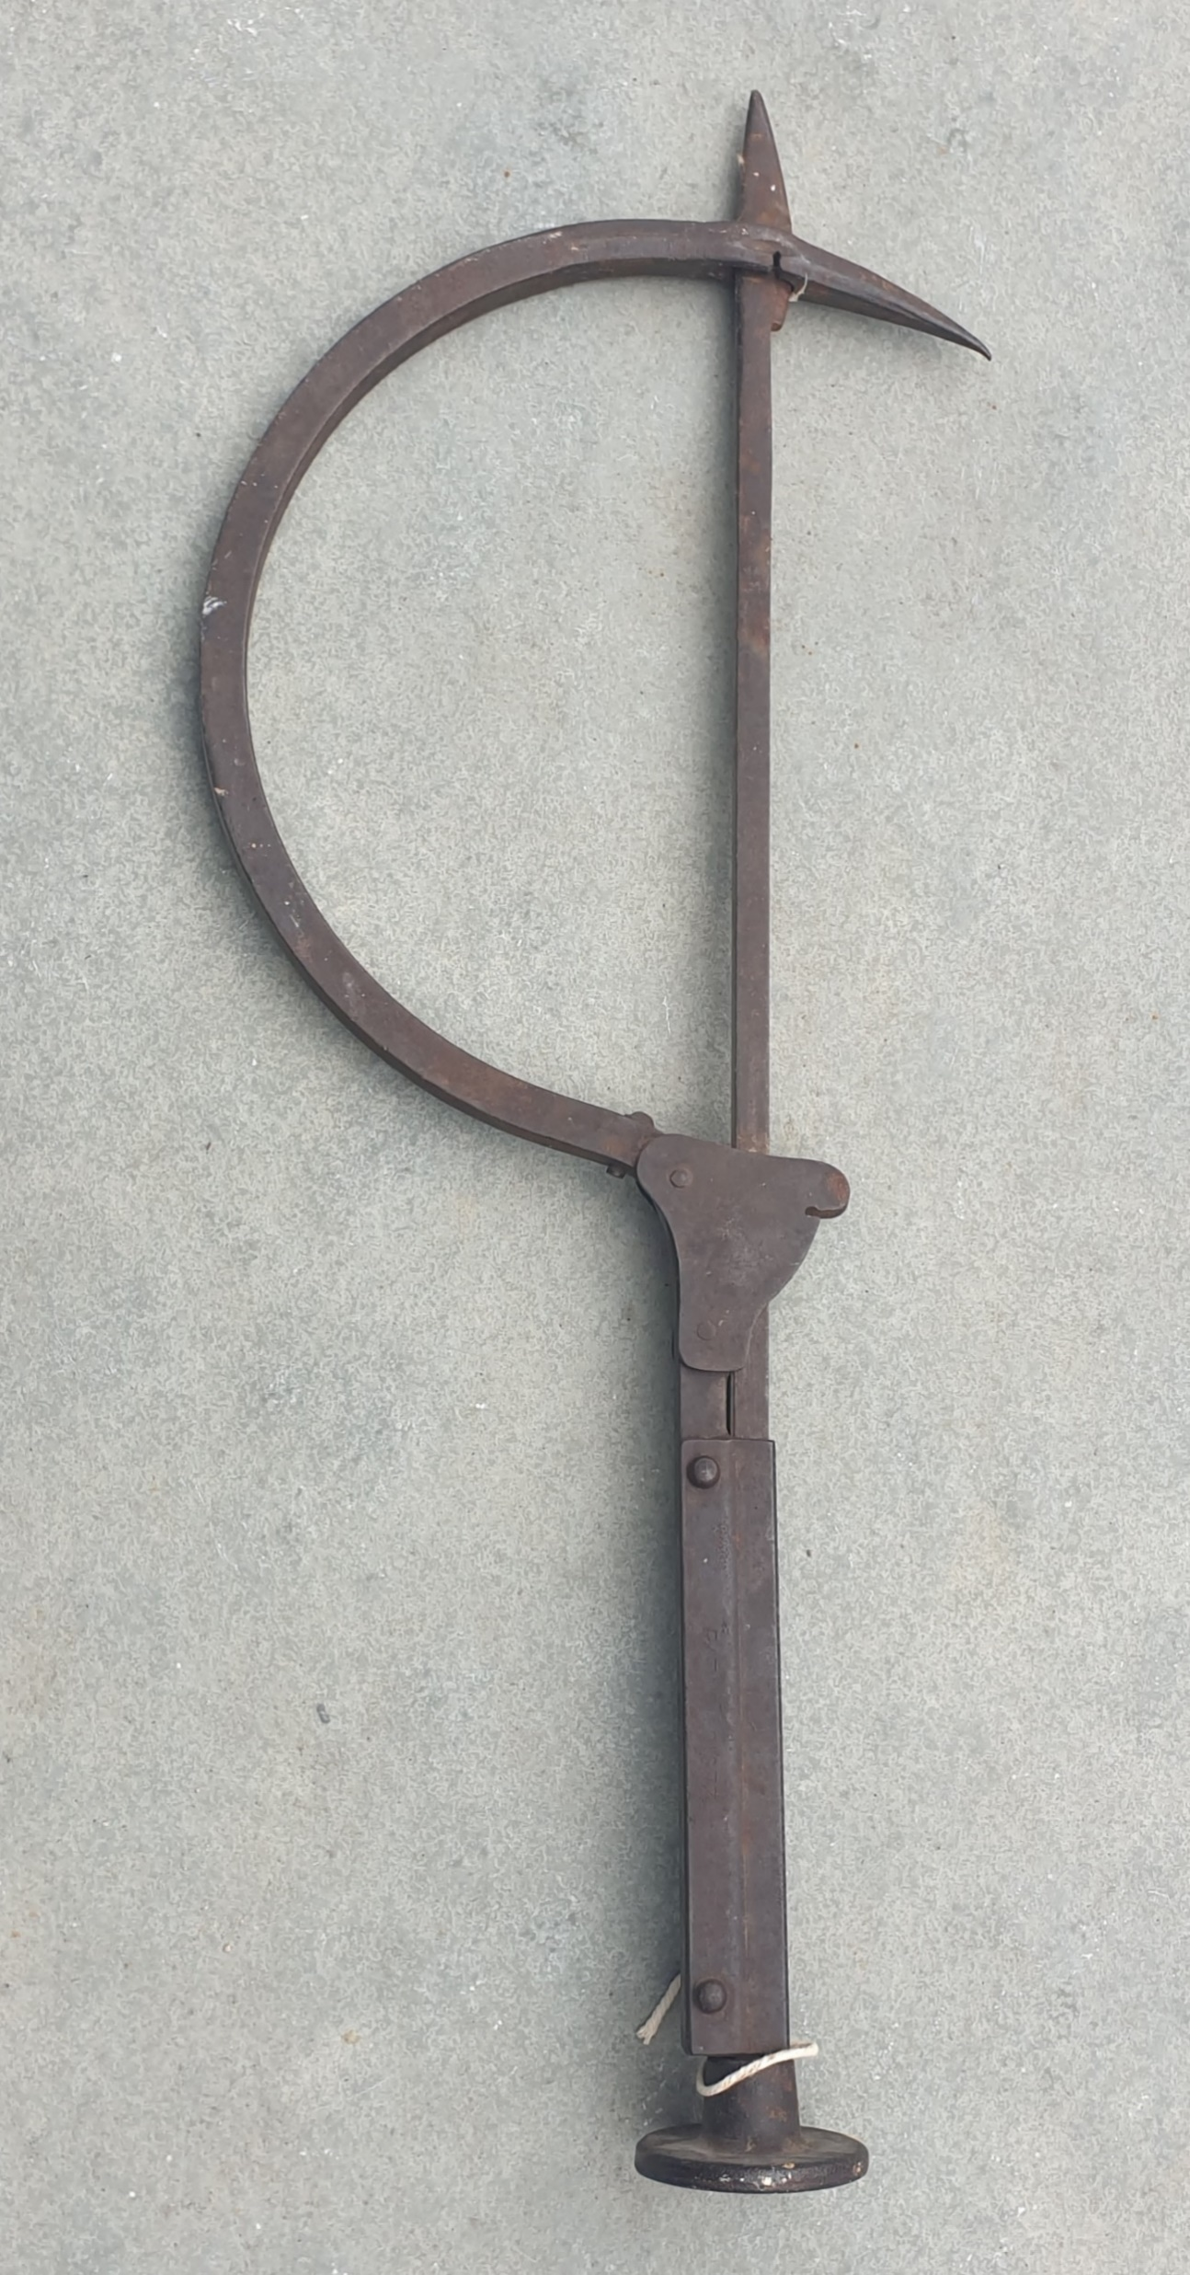
Thatchers used straw or reeds for roofing cottages.
Here are some of the tools used by a thatcher to
make sure the roof is strong, safe and waterproof.
A thatched roof would last for about 30 years.
Here is a thatcher’s needle. It is quite big - about 60cm long.
This is a mallet used to level up the thatch.
Notes:
Thatcher’s tools of the trade.

Slide 21
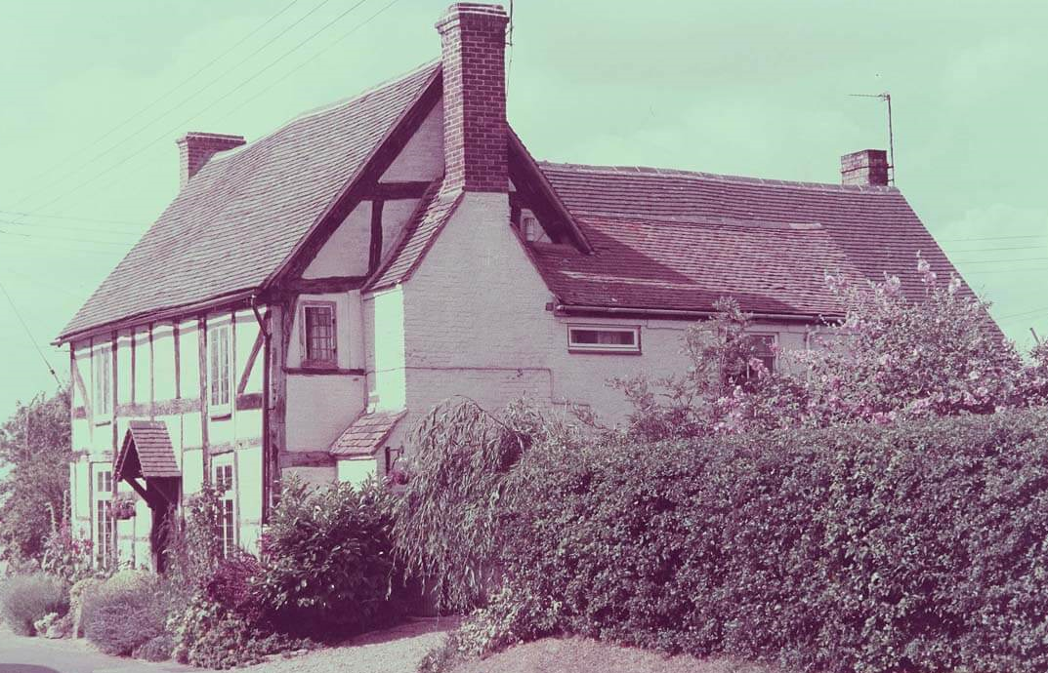
Endon Farm
House Folder No: 10
ENDON FARM
This old farm has a chimney stack
built against the outside wall. This
means they did not have a chimney
inside the original older house, just
a fire-place with an open hearth.
This was the home farm belonging
to Endon Hall on the other side of
the Turnpike Road.
We can look for Endon Hall mansion on one of the old maps?

Slide 22
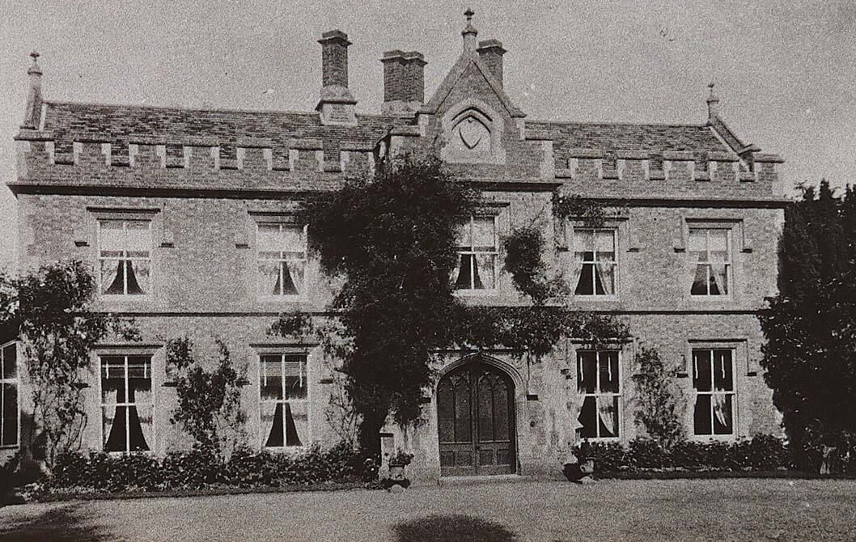
Wick Grange
House Folder No: 11
WICK GRANGE
This fine mansion house
had 14 rooms! The nearby
farm belonging to the owners
was well known for growing
excellent plants called hops.
People came from all over
the Midlands to pick the hops.
They lived behind the farm in
temporary sheds just for the
Hop-picking season.
Do you know what hops looked like and what they were used for?
Pictures and more information on next slide.
Notes:
Hops were used in the brewing of beer to make it taste nicer. Different hops give different flavours.

Slide 23
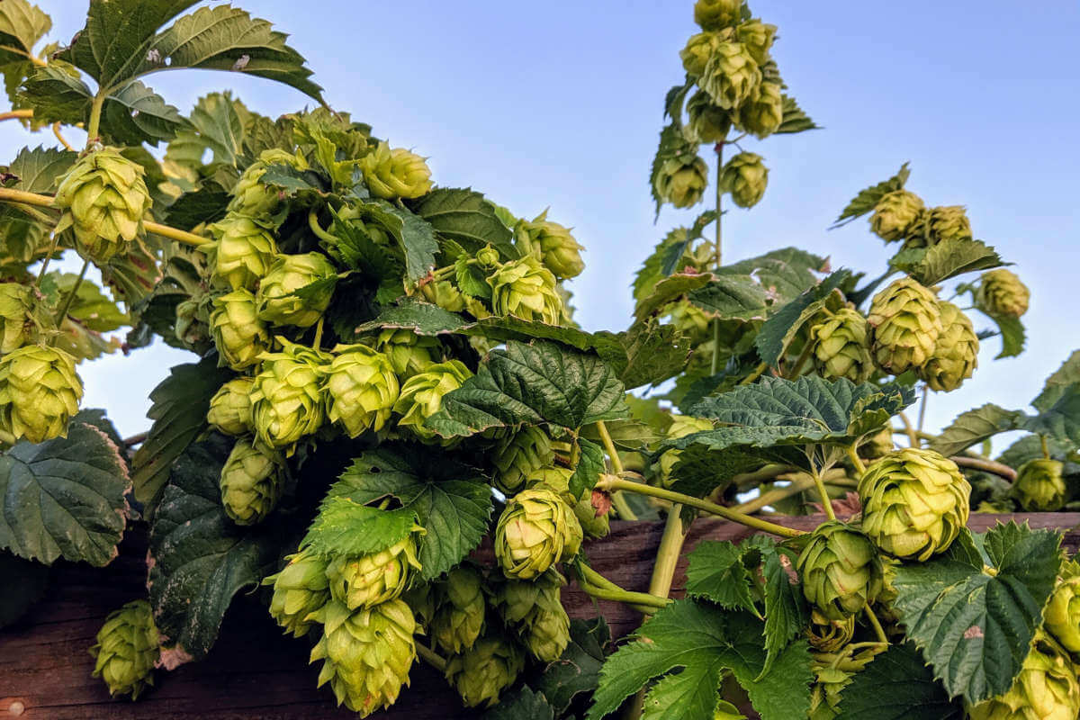
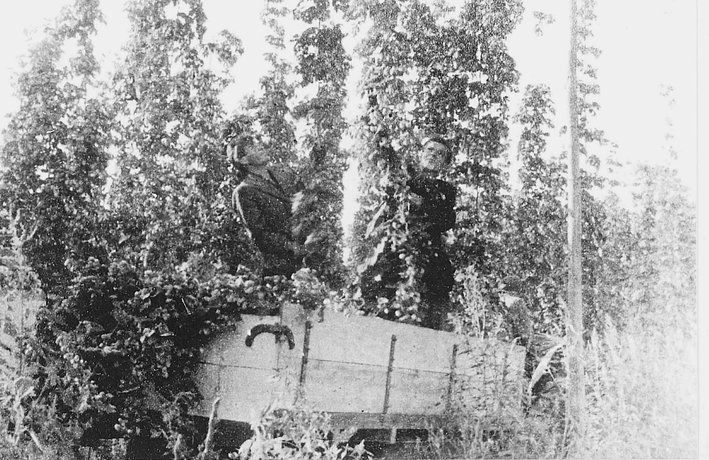
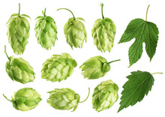
The History of Hops
Hops originally came from Egypt. They have been used in brewing beer for thousands of years. Hops first came to England from Flanders in the 15th Century and they are still grown and used in brewing today!
This is what the hop plant looks like. They have quite rough scratchy leaves but they smell quite nice when fresh.
Cutting down the hops from the hop poles on a Wick farm

Slide 24
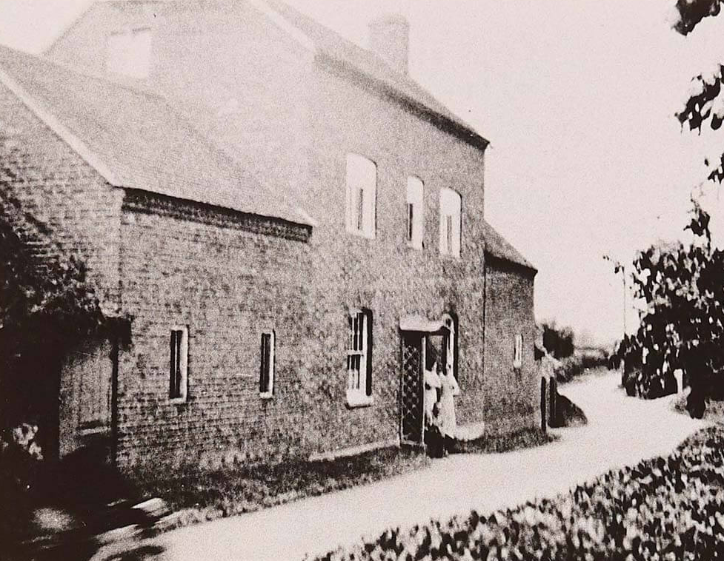
Woodwards Farm Cook Hill
House Folder No 12
WOODWARDS FARM
This house is no longer part of
a farm. But we have found old
documents from 1820 showing
John Woodward, a dairy farmer
lived there and in 1855 his son
took over the farm. But by 1900
a different family lived there.
What sort of animals does a dairy farmer
keep? And what sort of produce do they make?
Notes:
Cows for milk and cheese.

Slide 25
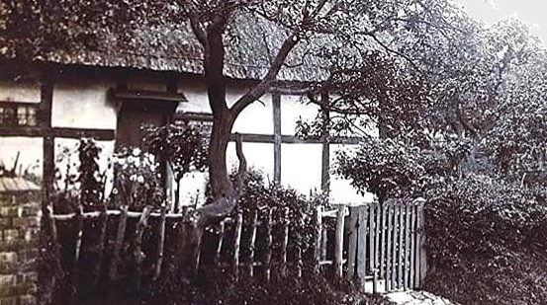
Mrs Carter’s Cottage
House Folder No: 13
MRS CARTER’S
COTTAGE.
This lovely old cottage
fell into disrepair
and had to be
demolished.
There is now a new
house on the site.
Later we can find out where it used to be on an old map - somewhere in between Taylor’s Cottage and Endon Farm?

Slide 26
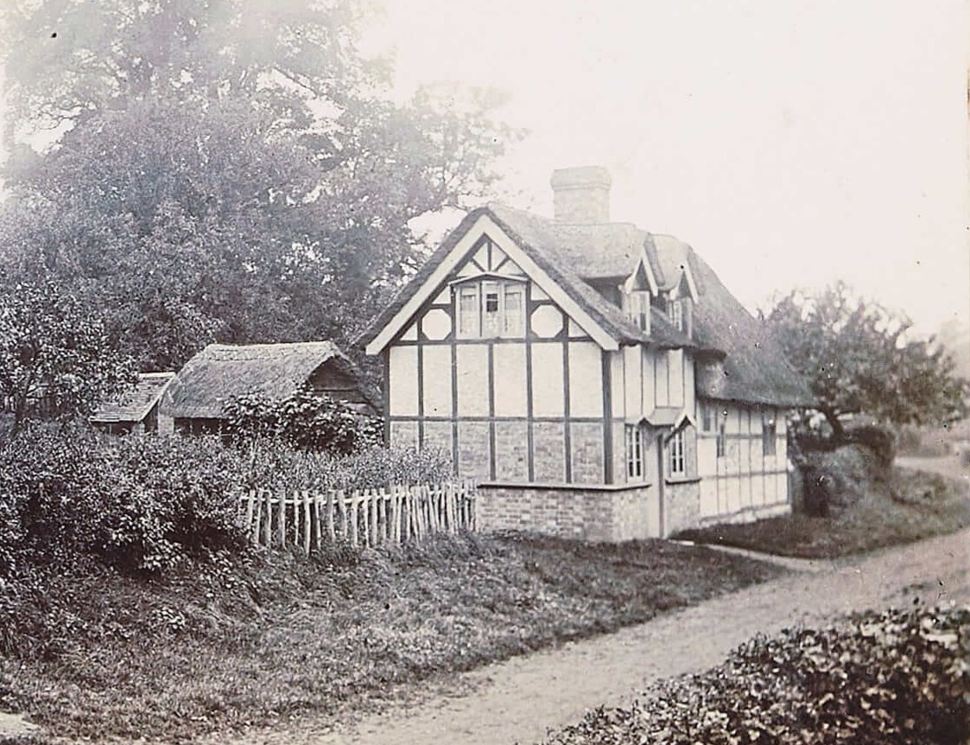
Taylor’s Cottage
House Folder No: 14
TAYLOR’S COTTAGE
Originally this was a tiny
cottage with just one or two
rooms downstairs and one
bedroom with another
small bedroom on the landing.
Notice the village street in
front of the cottage, it is just a
muddy track.
See if you can work out which is the oldest part of the cottage.
Notes:
The old part of the cottage is the part furthest away, with the long low thatched roof.

Slide 27
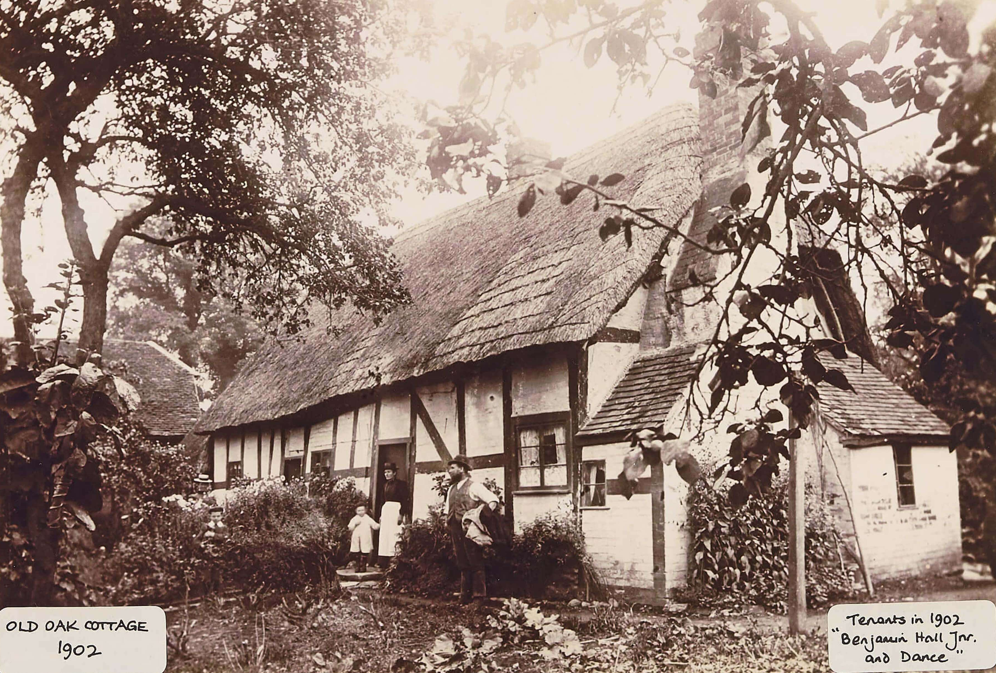
Old Oak Cottage
House Folder No: 15
OLD OAK COTTAGE
The Hall family lived in Wick for
hundreds of years. Benjamin Hall
junior was registered in this
cottage on the Census of 1901 and
a Mr Dance also lived there as
a boarder, until he married and
had a family.
Can you remember what this sort
of square timber-framing is called?
Notice the small windows and outside chimney
Notes:
This type of framing was called BOX FRAMING.

Slide 28
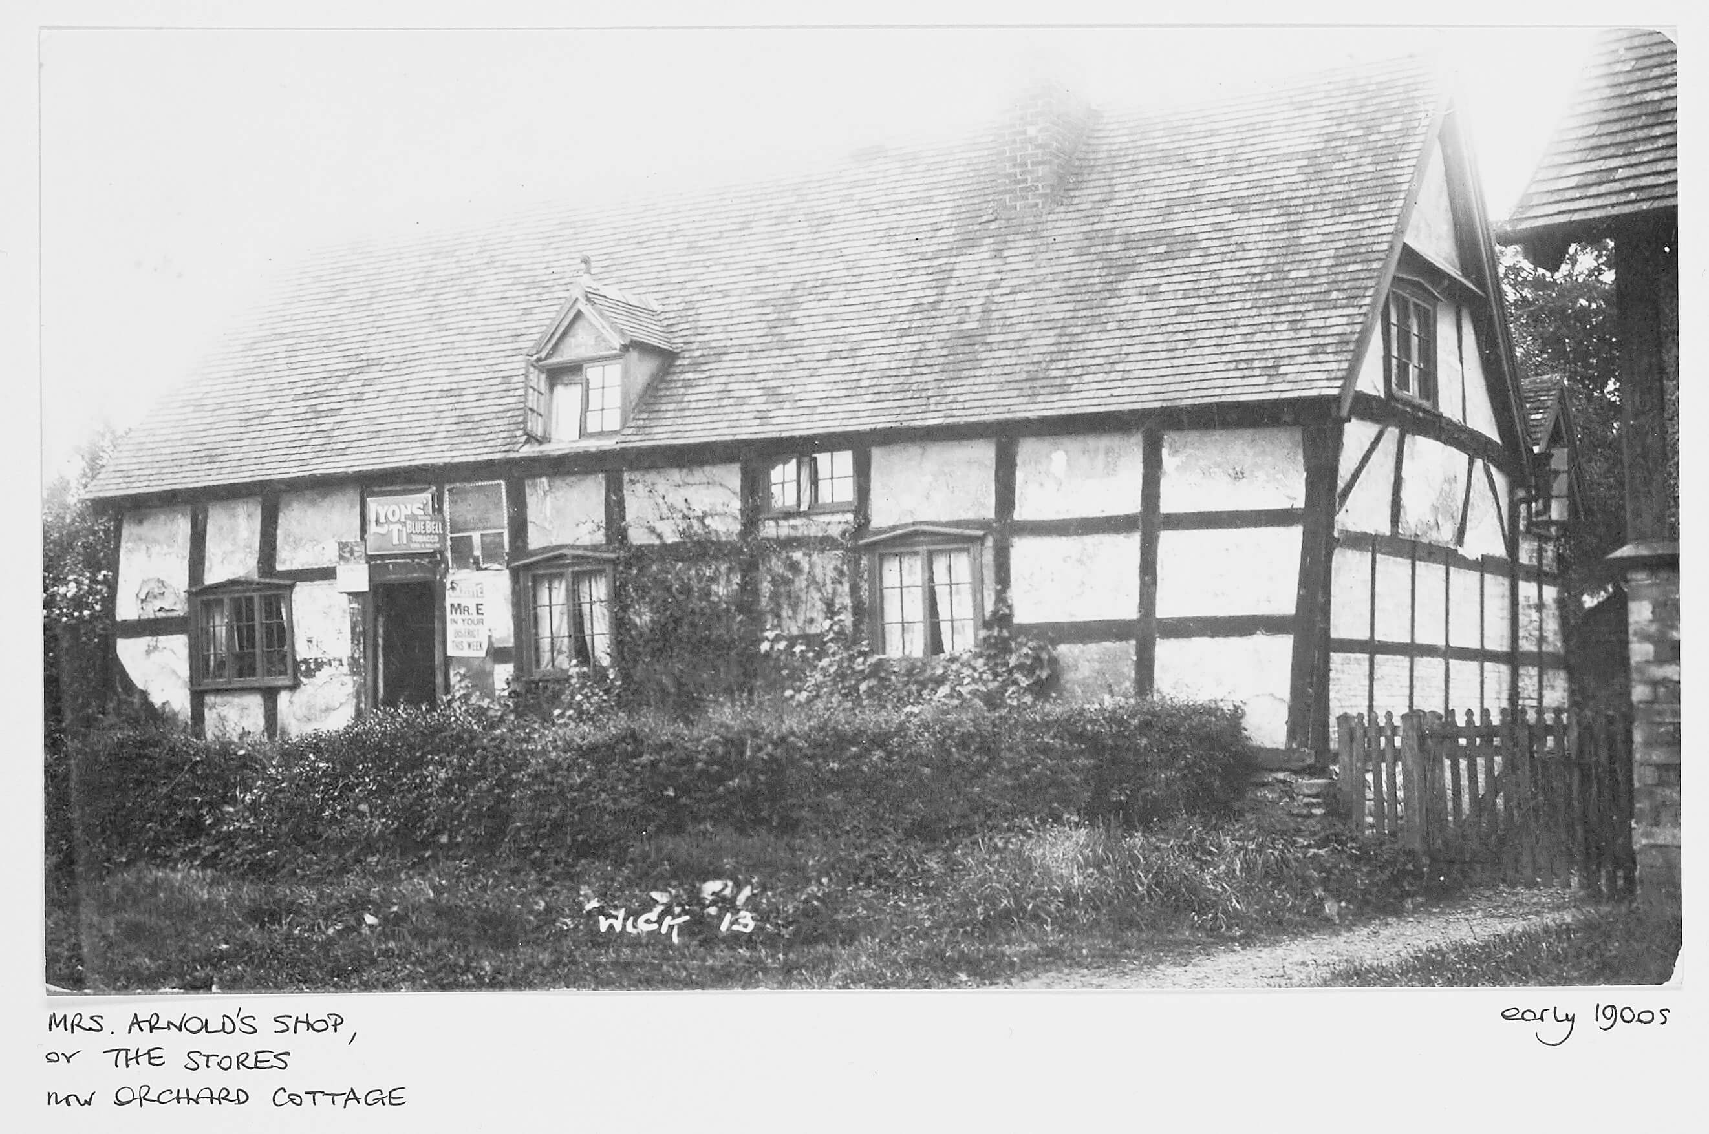
Orchard House
House Folder No: 16
Orchard House
This is another lovely
box-framed cottage.
It was the village stores
(shop) for many years.
See if you can find out what
it says on the signs above
and around the door?
Notes:
Lyons Tea, Blue Bell Tobacco, and a sign saying Mr E will be in the district!

Slide 29
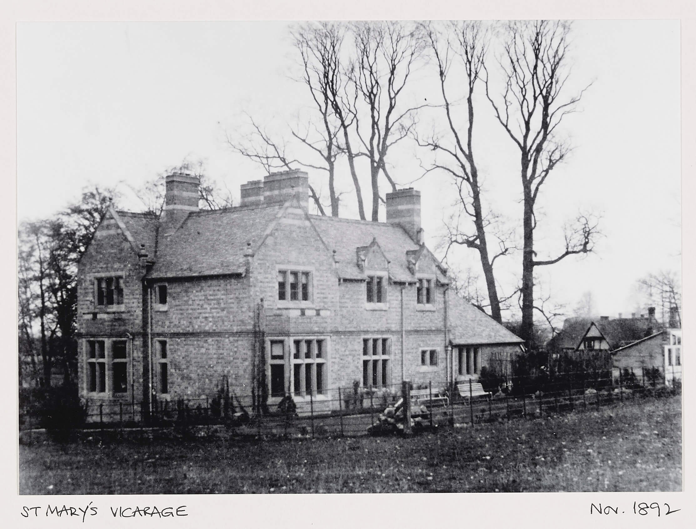
THE VICARAGE
House Folder No: 17
The Vicarage of St Mary’s Church
This vicarage was built in 1889 but
there was probably an older house
on the site. The vicar sometimes lived
in Pershore but the curate lived in
Wick and took some services.
Can you find out how old St Mary’s
Church is? Confusingly, in the past it
was also known as St Lawrence’s and St Bartholomew’s.
Notes:
The Church was probably built in the 12th Century and largely extended in the 16th century, later restored in 1859-60.

Slide 30
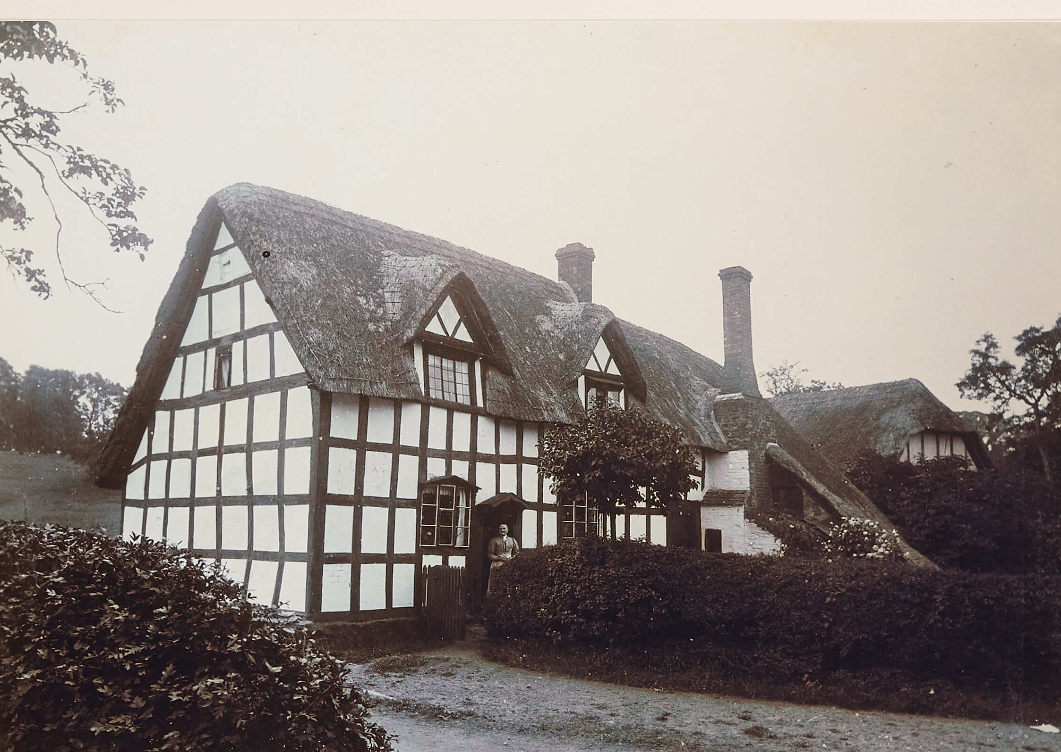
Gardener’s Cottage
HOUSE NO. 18
GARDENER’S COTTAGE
This is a fine box-framed cottage with
a thatched roof. It is a large cottage for
a working gardener so may have been
made bigger and became the home
of the estate farm bailiff, who worked
for the landowner.
See if you can find out what a farm bailiff did as his job?
Notes:
A farm baliff was responsible for the land and estate management of the lord of the manor. And liaising with the villagers about the crops grown, ditche dug and fences mended and rented houses, barns and sheds were repaired.

Slide 31
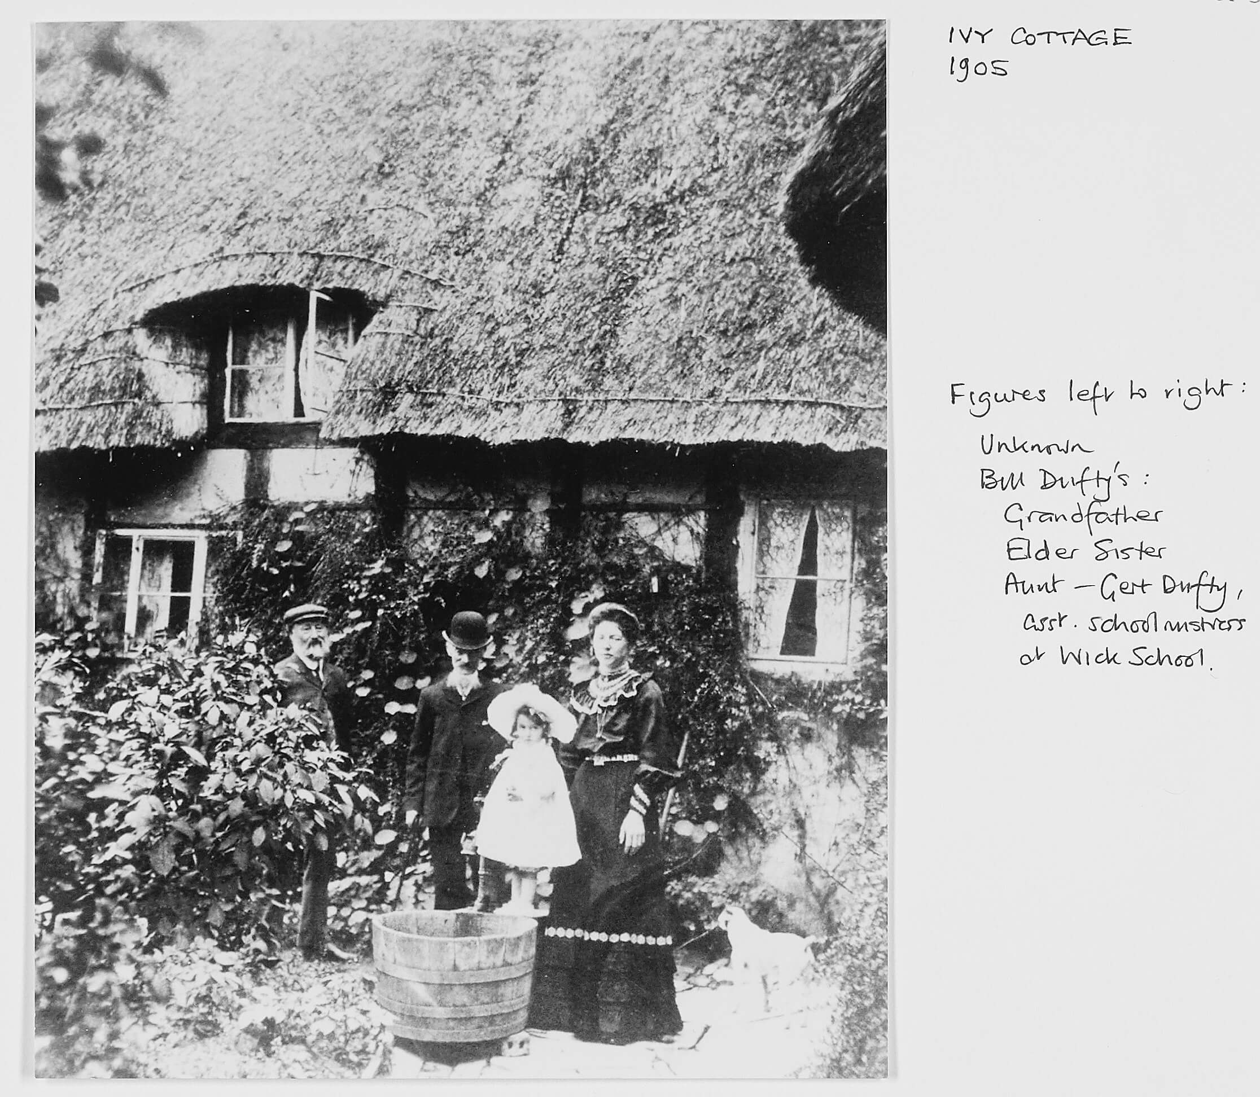
Ivy Cottage
House Folder No: 19
IVY COTTAGE
We know the names of the people in this
1905 photograph! Their surname is Dufty
and the lady was Gertrude, an assistant
teacher at the school. They are wearing
smart clothes. Notice the old barrel the
little girl is standing on.
What were barrels used for originally and
what were they made of?
The next slide shows more old barrels.
Notes:
Barrels were made of wood usually with iron hoops to hold them together. They were used for holding liquids but mainly beer and cider.

Slide 32
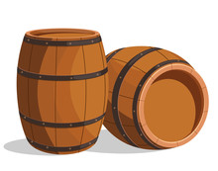
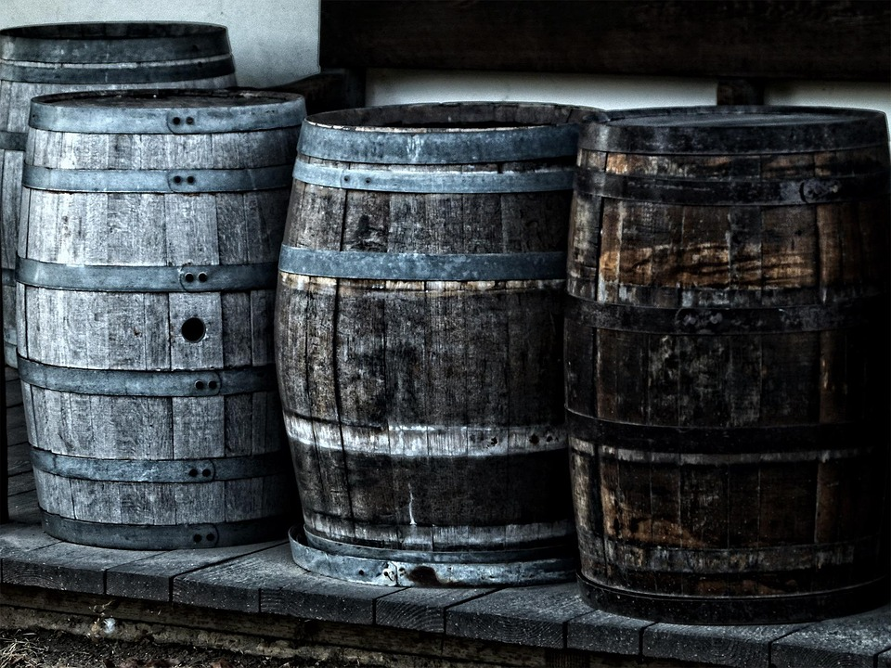
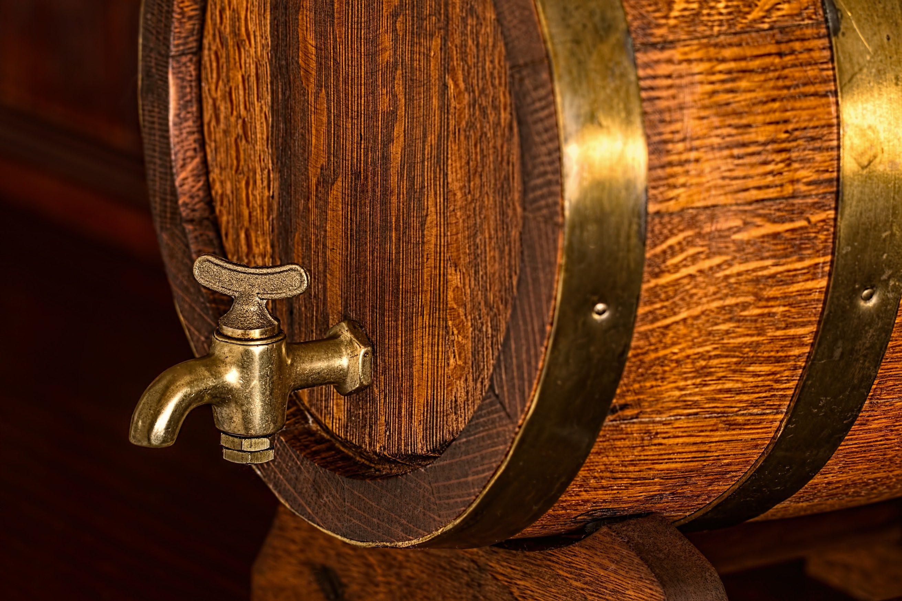
Barrels
Barrels were made from wood and iron by a cooper and that is where we get the surname Cooper. The barrel is constructed from separate pieces planks held together with iron rings. They have a flat wooden top and base and sometimes a tap.
Barrels have been made for thousands of years and are still used today.
A very smart barrel with brass rings and brass tap
Some very old barrels waiting to be reused.

Slide 33
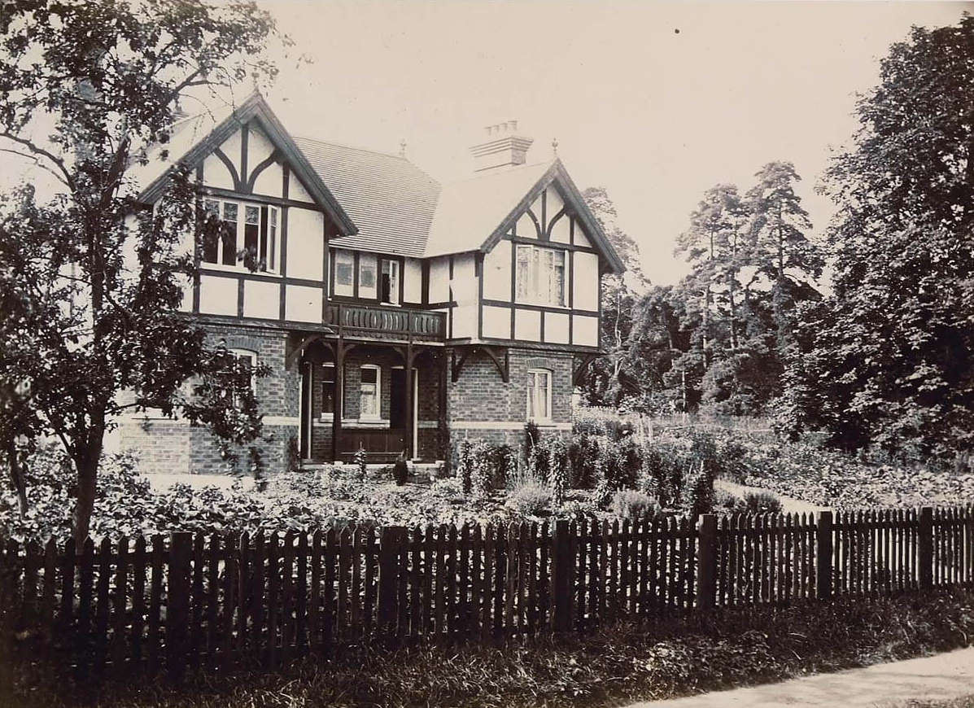
Dorinda Cottages
House Folder No: 20
DORINDA COTTAGES
This pair of houses are newer
and look different because
they have bricks on the
lower part, bigger windows
and a tiled roof. But even this
house was built over a
hundred years ago!
What do you call two houses when
they are joined together?
Notes:
Two house joined together are called a semi-detached house. If there are more than two houses joined together in a row then that is called a terrace of houses.

Slide 34
THAT IS THE END OF OUR QUICK VISIT TO THE VILLAGE OF WICK OVER ONE HUNDRED YEARS AGO!
Please open your House Folders.
It is time to start your own investigations.
You will now become Wick History Detectives
discovering some interesting facts about the family that lived in your house or cottage.
Notes:
Please hand out the house folders to pairs of students.
Please also note that earlier rural censuses did not specify the addresses of some of the villagers. So by using all the information available, number of rooms, the recording system and the probably route of surveyors who collect results of censuses, we have had to make an informed guess as to which cottages or houses some of the families were living in at that time.

Slide 35
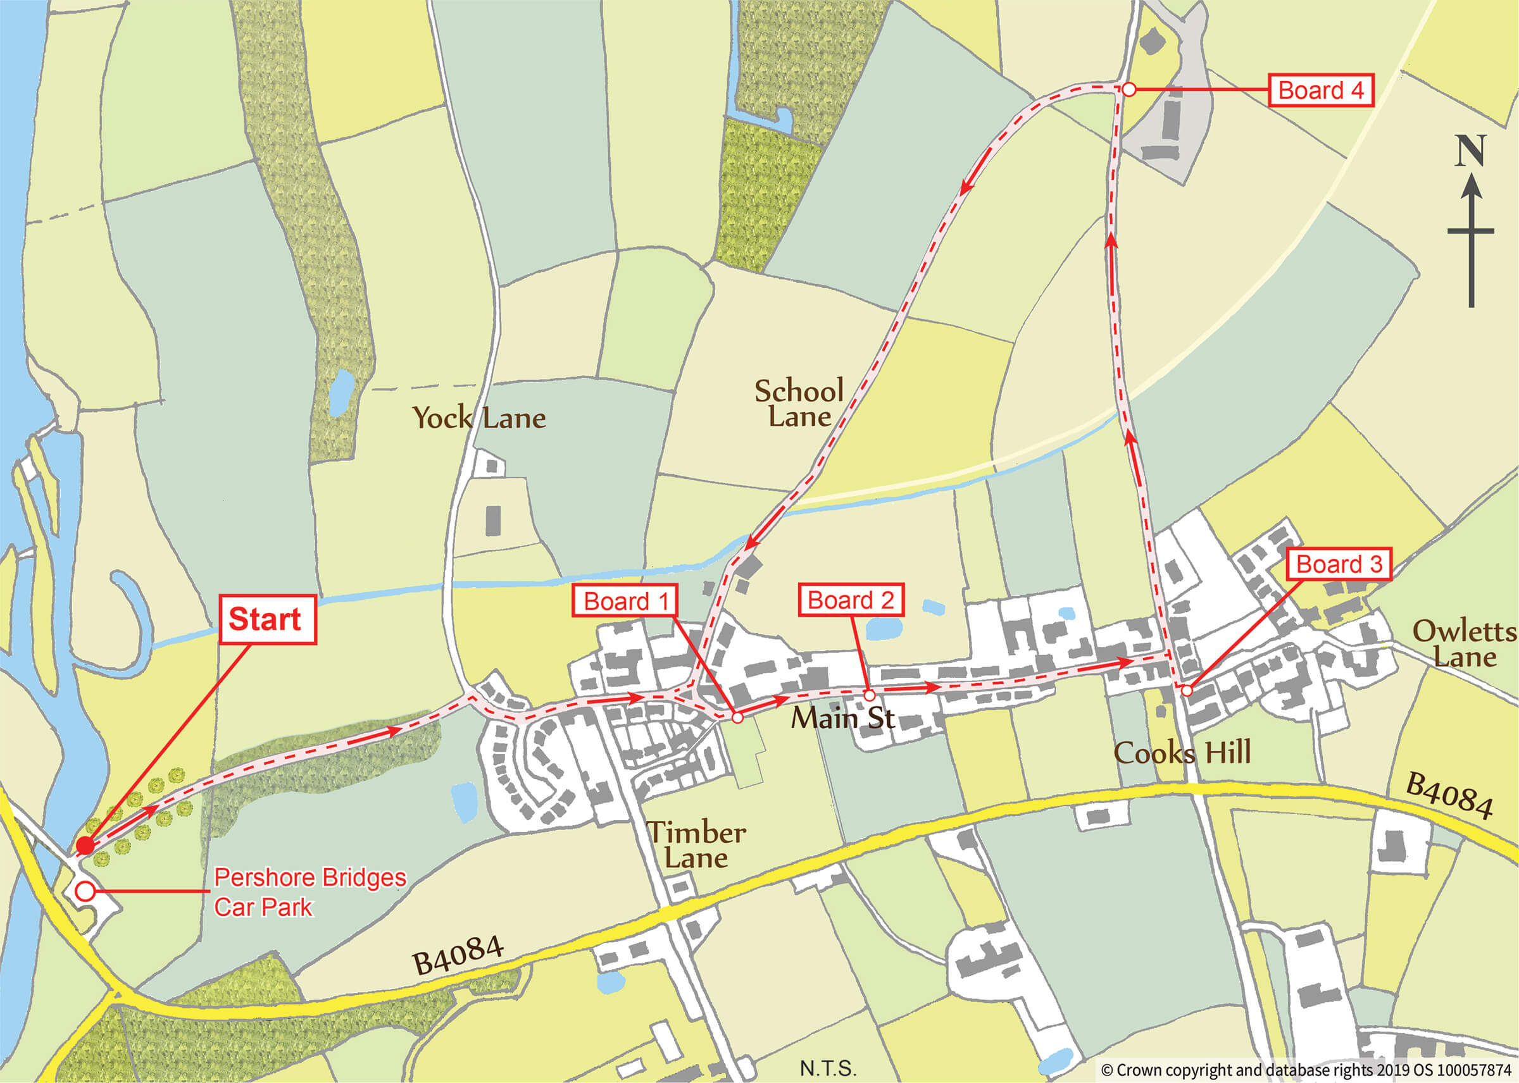
WICK HISTORY TRAIL
If you would like to walk around Wick
after you have done this history study,
you will be able to see all the history information boards along the trail route.
Look up: Wick History Trail website for more information - press ctrl and click on link below
http://www.wickhistory.co.uk/
Notes:
Click on the Wick History Trail Website for further photographs and information.

Slide 36
THE END
Please note that earlier rural censuses did not specify the addresses of some of the villagers. By using all the information available, number of rooms, the recording system and the probable route of surveyors who collect results of censuses, we have been able to make an informed guess as to which cottages or houses some of the families were living in at that time.
Copyright of this PowerPoint presentation belongs to Deborah Overton and Wick Parish Council,
in support of the Wick History Trail and is available only through their website.
Notes:
Please note that earlier rural censuses did not specify the addresses of some of the villagers. By using all the information available, number of rooms, the recording system and the probable route of surveyors who collect results of censuses, we have been able to make an informed guess as to which cottages or houses some of the families were living in at that time.

Slide 37
Extension Activity Look on next slide to examine an older map of 1884.

Slide 38
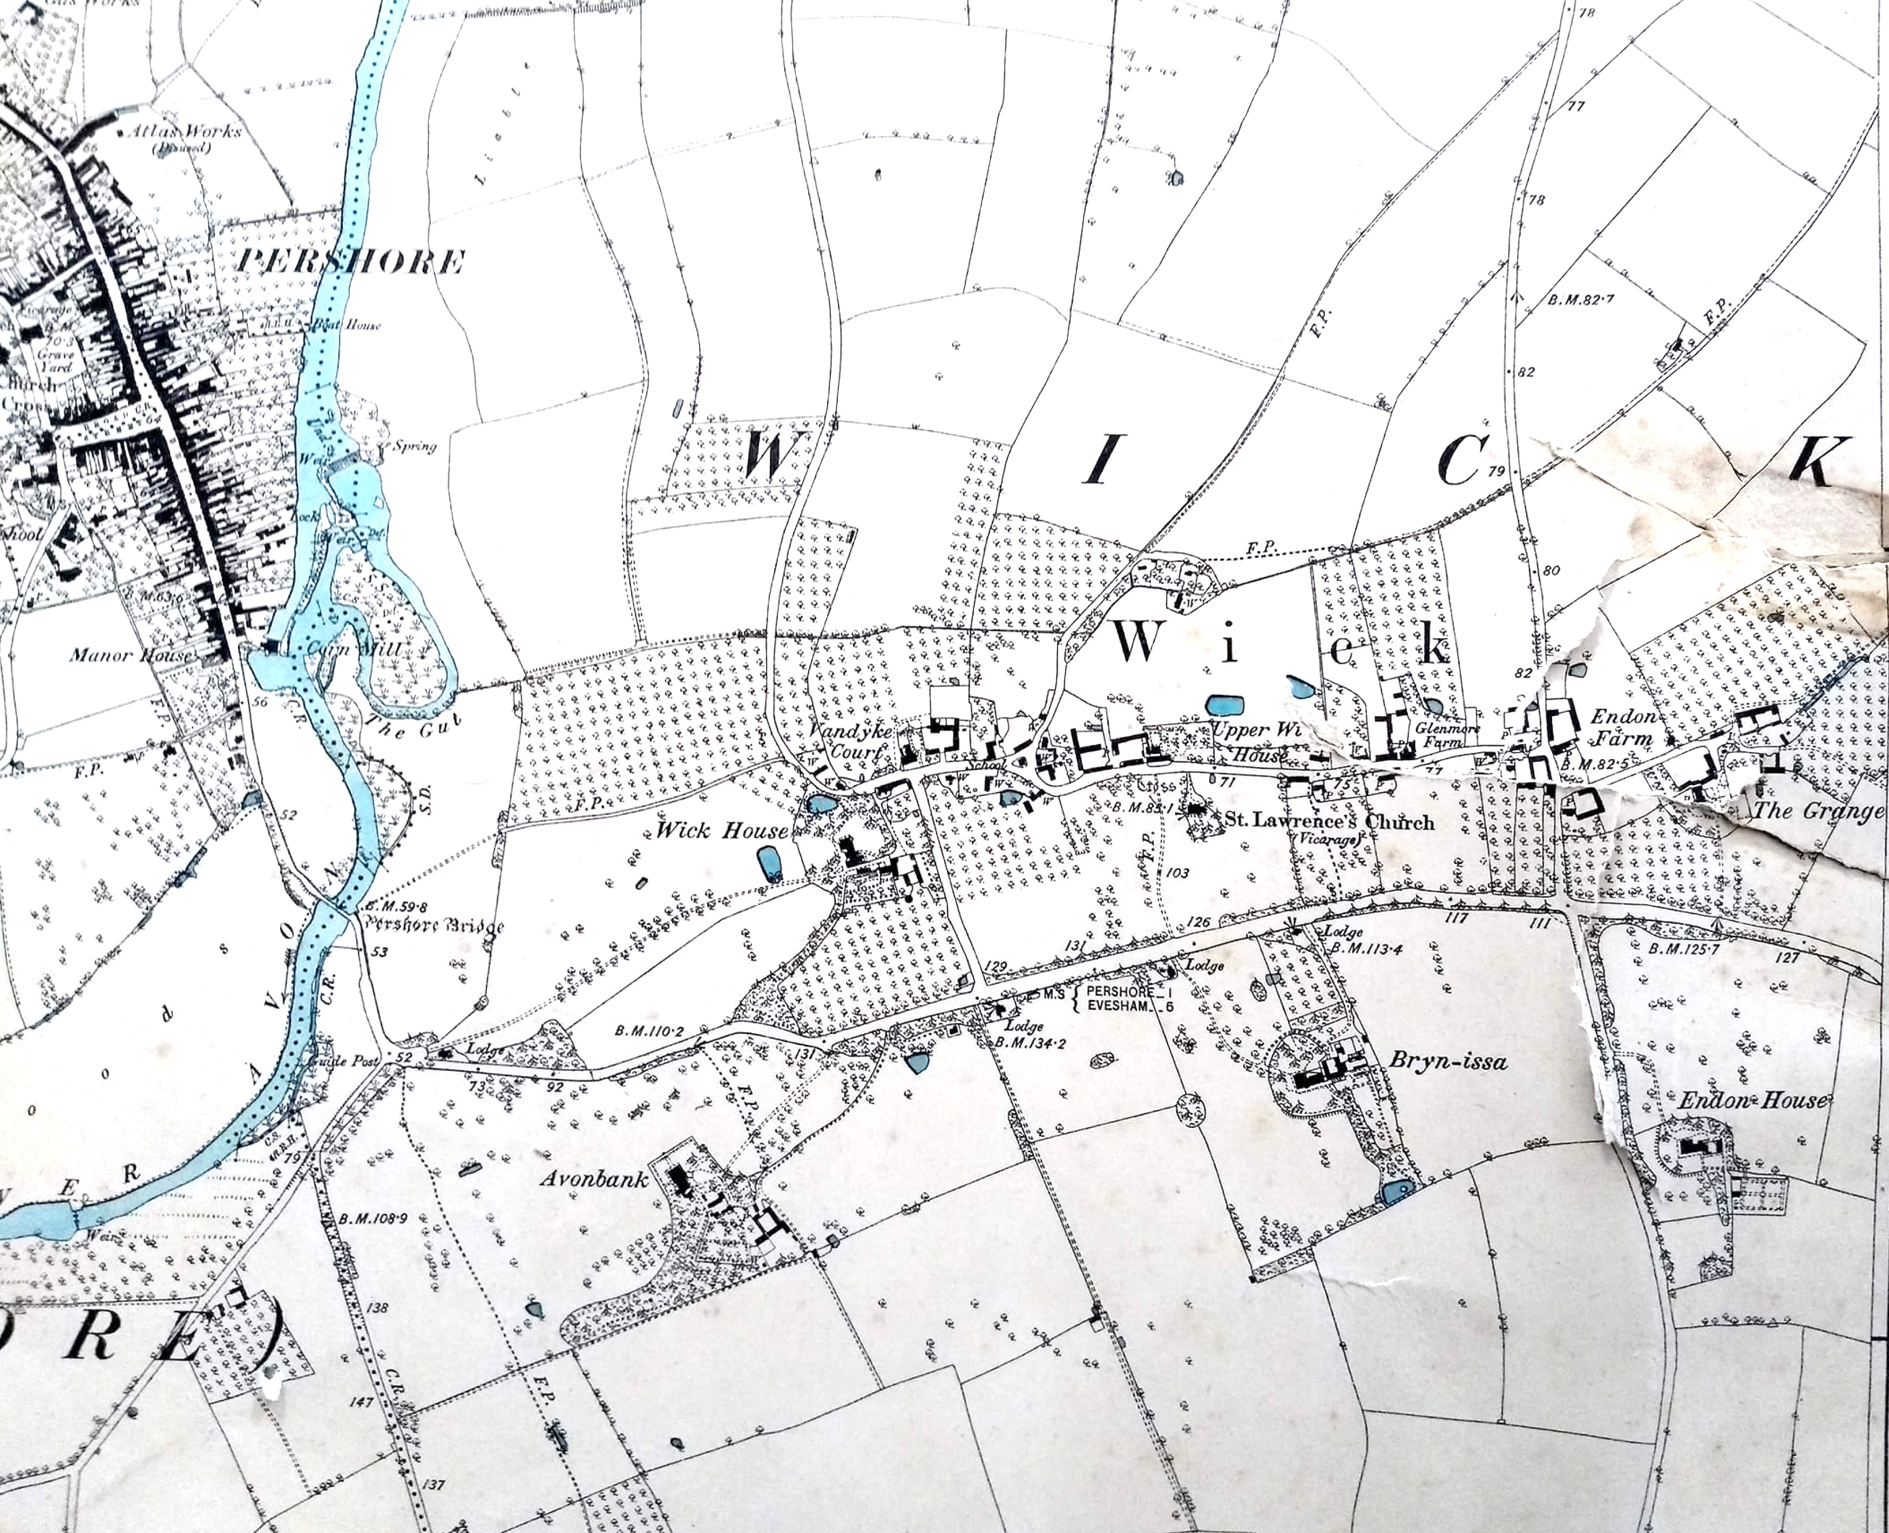
Wick OS Map of 1884
Extension Activity
This older map (1884) is more complicated. Notice all those little dots. Those are all the trees in orchards around the village. Can you see the river and Pershore Bridge again?
1) What are orchards?
2) What might have been grown there?
3) Do you know the fruit that Pershore is most famous for? There are two sorts – what are they called?
Notes:
Orchards are full of fruit trees which grow apples, crab apples, pears and cherries. Worcestershire had thousands of acres of orchards. The famous fruit is the Pershore Plum and that is why Pershore has a plum festival every year. Resource: To find out more about orchards look at The Primary School Lesson plans of The Orchard Project on-line.

Slide 39
THE END
Copyright of this PowerPoint presentation was created by Deborah Overton and Ellen Honeybunn
for Wick Parish Council,
in support of the Wick History Trail and is available only through their website.
Contact: Wick History.co.uk For any further information or queries.
Notes:
https://www.wickhistory.co.uk/contact/

