Slide 1
WICK HISTORY DETECTIVES
A Local History Study
An interactive PowerPoint for KS2 teachers and pupils
based on a study of the houses and people
of Wick in Worcestershire in the early 20th Century.
It can be used as a stand-alone history study project or in conjunction with the Wick History Trail around the village.
Created and produce by Deborah Overton and Ellen Honeybunn.
Teacher’s Resource : Link to History Trail Website : http://www.wickhistory.co.uk
All photographs and maps are the copyright of Wick History Trail Website and Wick Parish Council. Please do not reproduce in any form.

Slide 2
Introduction to the Wick History Study
Educational Pack
This PowerPoint will guide you through a study of the historic maps of Wick, near Pershore in Worcestershire. It will then show a selection of photographs taken in the early 20th century of the houses and cottages and introduce students to the Census of 1911 and the information it contains.
Each slide has information/answers to questions held within the teachers notes.
The PowerPoint is supported by 20 individual sets of maps within the Education Pack in individual numbered files called House Folders. Allocate a file to a pair of students. They can then look at the maps and investigate their house or cottage to discover who lived there and what jobs they did during the Edwardian period.
There is also additional supporting information for teachers in a separate
file folder, to choose to use in class or not.

Slide 3
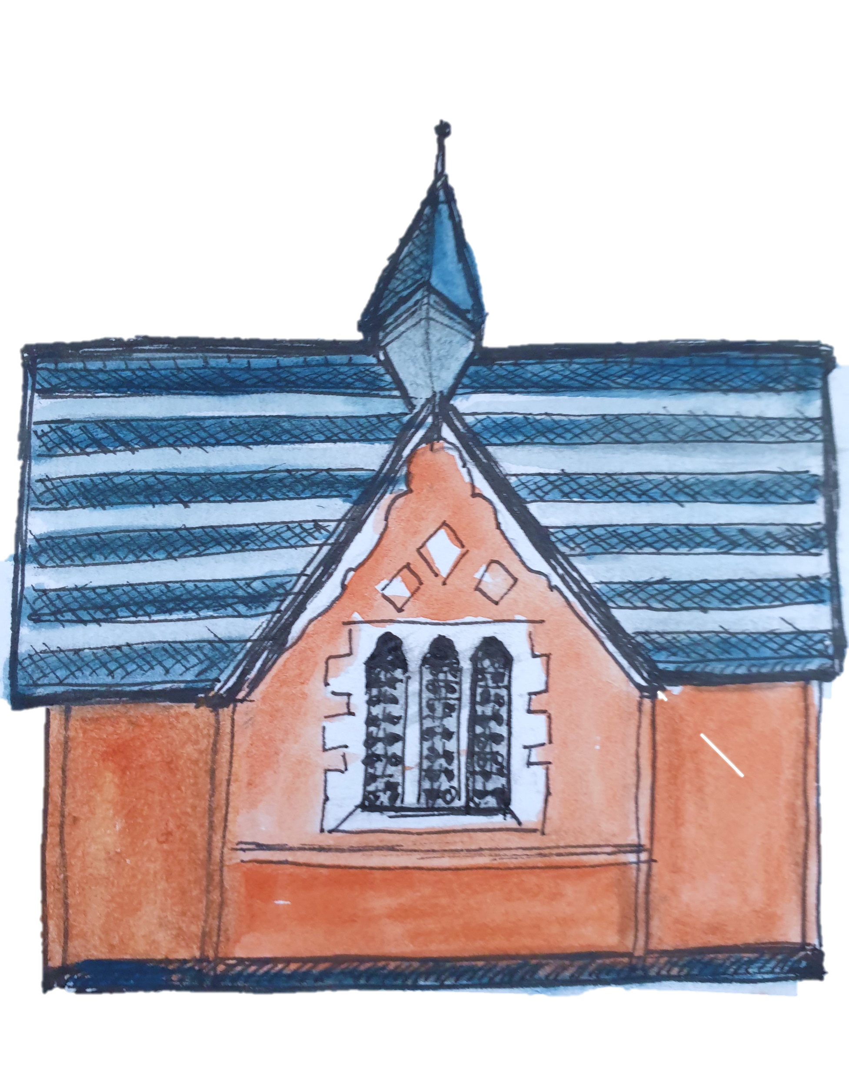
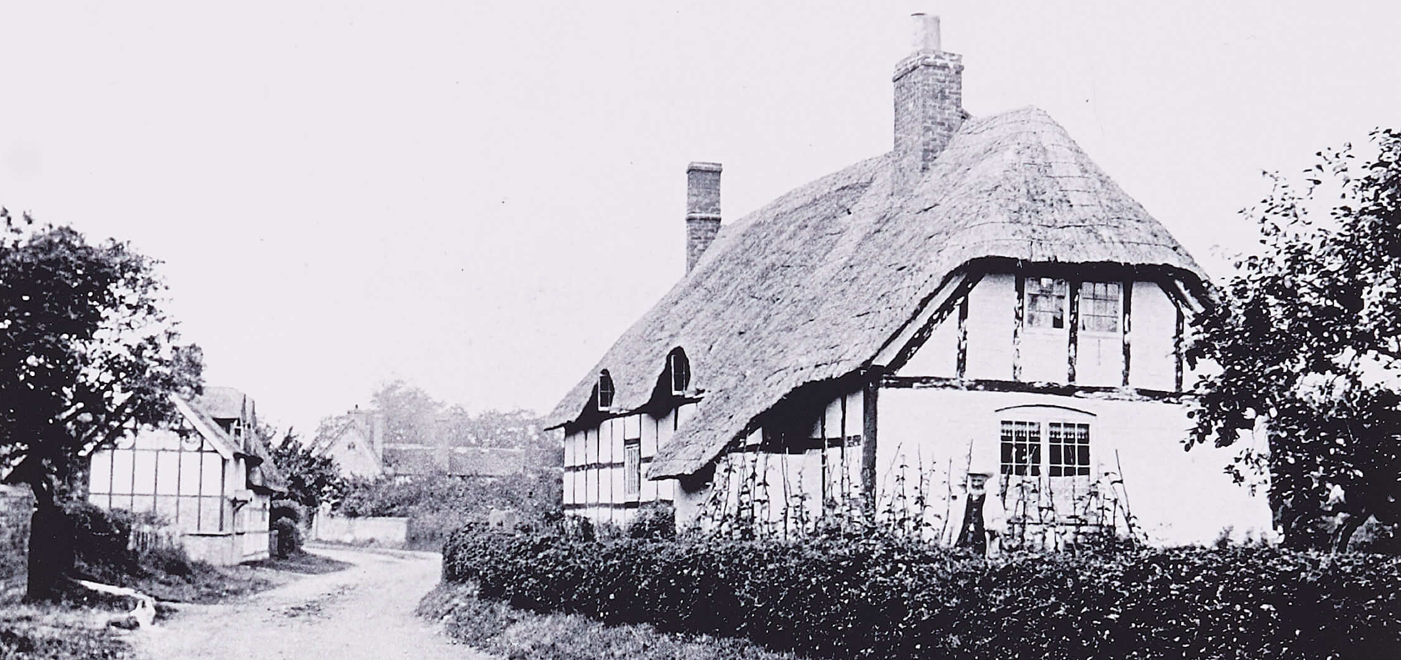
So let’s get started with our History Study by becoming Wick History Detectives
This is a photograph of the village of Wick over 100 years ago.
We will begin our investigation by finding out where the village of Wick is
on a new map and then look at some very old historic maps.
But first we need to find out what maps are.

Slide 4
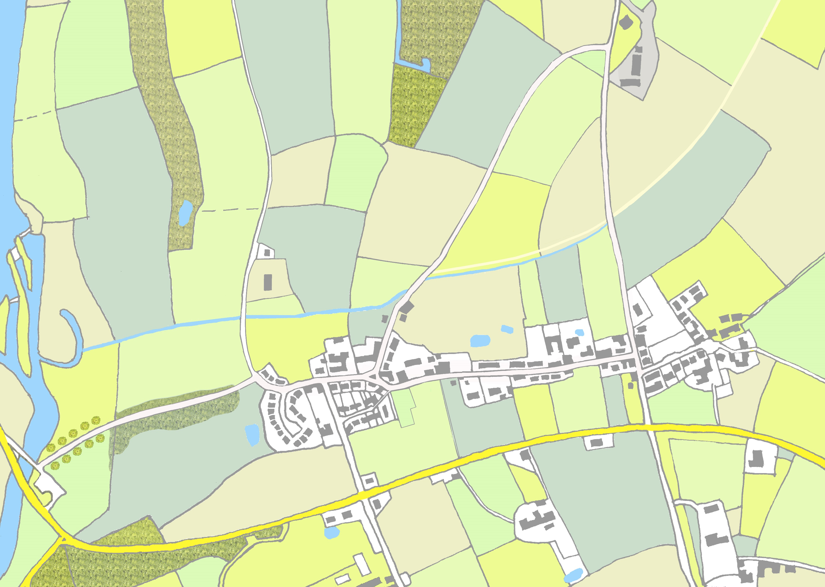
SESSION ONE
MAPS * THE LAND * THE SCHOOL
What are maps?
Imagine you are flying over Pershore and along the river, floating across the fields to the village of Wick. You can see the town, roads, streets, river, the fields and the houses and buildings.
A map is a drawing like a plan of what you can see
below you. It looks a bit like a cartoon picture.
Here is a simple map of Wick. We will look a bit closer
on the next slide.

Slide 5
A modern map of Wick Village showing the houses.
Here is a simple modern map showing the village of Wick and all the houses and buildings.
Can you see the blue river on the left-hand side of map. This is the River Avon that flows through Pershore.
What else can you see?
We will now look at some much older maps. Starting with Map 1.
Wick
Notes:
HAND OUT MAGNIFYING GLASSES IF USING THE PHYSICAL HOUSE FOLDERS

Slide 6
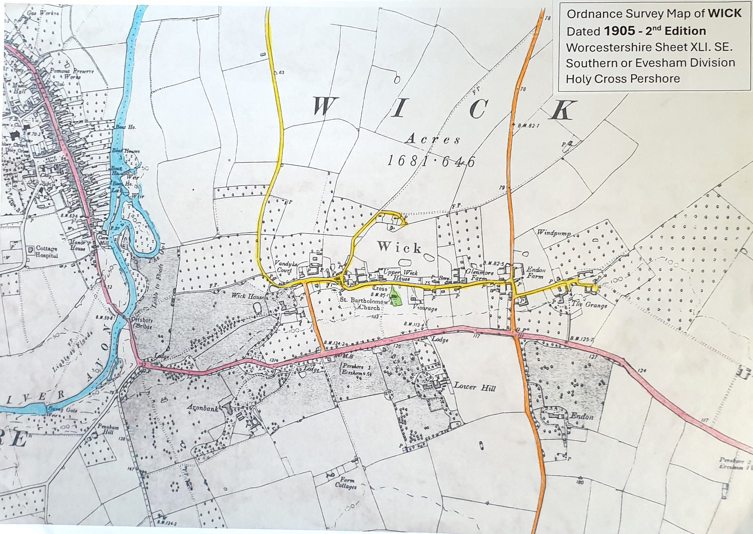
Map No: 1 - River and Roads – OS map 1905
SEE IF YOU CAN FIND:
The town of Pershore.
The River Avon in blue.
The big red road to Evesham.
Pershore Bridge.
A dotted line from Pershore bridge along footpath to yellow road – marked FP.
Wick House and two lakes.
Vandyke Court.
Upper Wick House.
The Church.
The Vicarage.
Glenmore Farm.
Endon Farm.
The Grange.

Slide 7
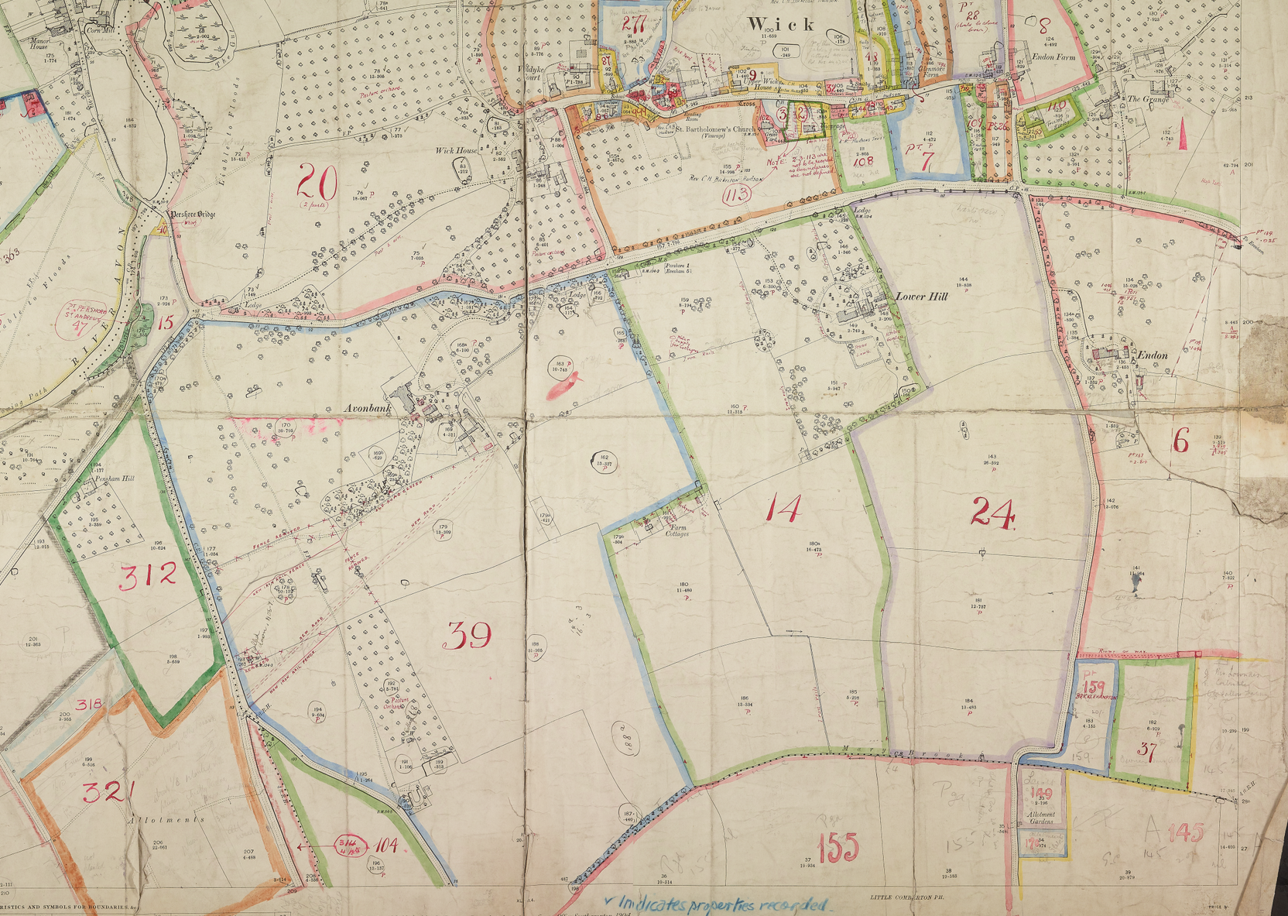

Map No: 2 - Wick Land Tax Survey of 1910
Map 2 was created by surveyors who worked for the government. They needed to find out who owned which piece of land, so they could charge them the right amount of tax money.
Notice the different coloured outlines around the fields and the numbers for each parcel of land. Each colour represents a different landowner.
We will zoom in closer to Wick on the next slide.

Slide 8
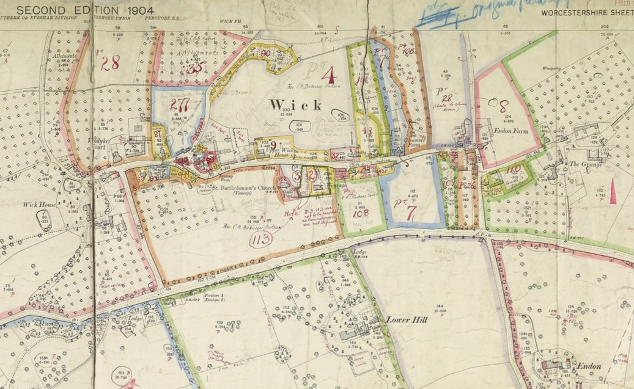
THIS IS THE SAME MAP ZOOMED IN CLOSER
Use your magnifying glass to examine the map.
Remember that Wick House is on the left and The Grange on the right-hand side of village. Can you find them again?
Notice the school is marked on this map – in a red triangle. Can you find it?
Map 2
Now get out your paper and pencil or slate and chalk and go to next slide for some questions about Map 2.

Slide 9
Get out your paper or slate and chalk and write your name on it and today’s date.
Here are some questions about Map 2.
Use your magnifying glass, then write the answers on the other side of the slate.
Write down the numbers on the land with blue boundaries.
What number is on the land around the ‘Smithy’.
Find number 35 and write down what the land is being used for.

Slide 10
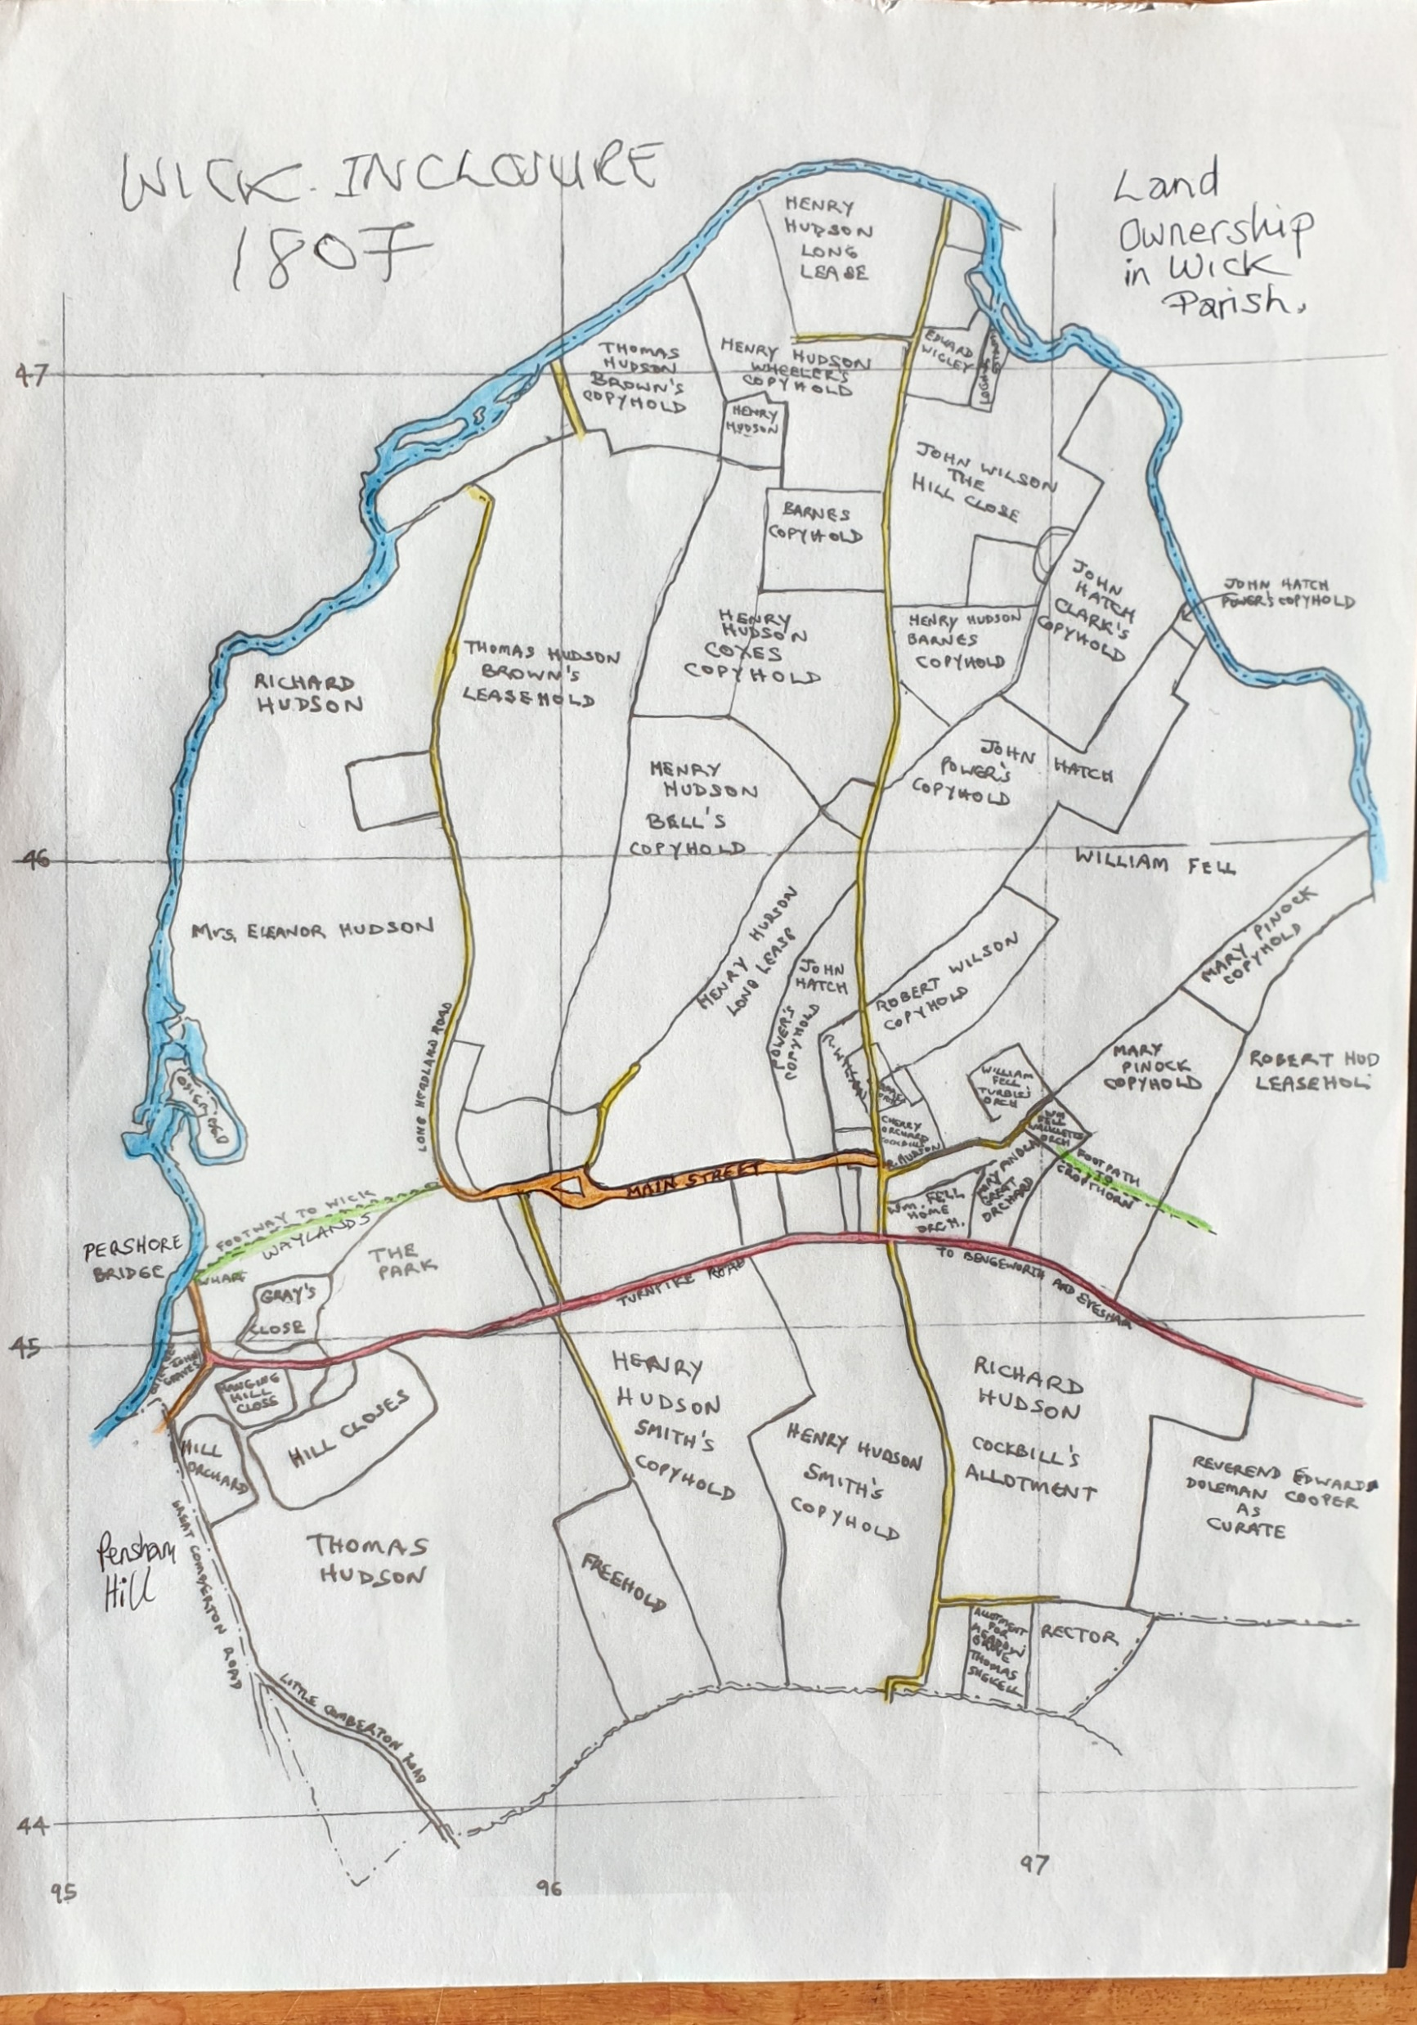
MAP No: 3 - Enclosure Map
This is the Wick Enclosure Map dated 1807. It shows all the landowners.
The houses and cottages are not drawn on this map but notice the river in blue and
the Turnpike Road in red, which is still the main road from Pershore to Evesham.
Which family are the main landowners - mark them off with your marker pen?
Notes:
Established by Acts of Parliament to sort out the terrible state of the roads which were often impassible in winter, Turnpike roads were constructed by individuals or groups of people called Trusts and were privately owned and managed. The roads had gates with spikes on them andtoll houses to collect the money at each end. People charged a toll to use them and these tolls varied depending on whether you were walking, riding a horse or in a carriage or cart or herding animals. Starting in the 17th century but expanding more rapidly in the 18th and 19th centuries. Although they were often much better to travel on, locally they were resented as people were charged too much use them. This occasionally erupted into violence. Gradually turnpikes declined when railways took over much transport uses - from people to heavy goods, fresh produce and live animals.

Slide 11
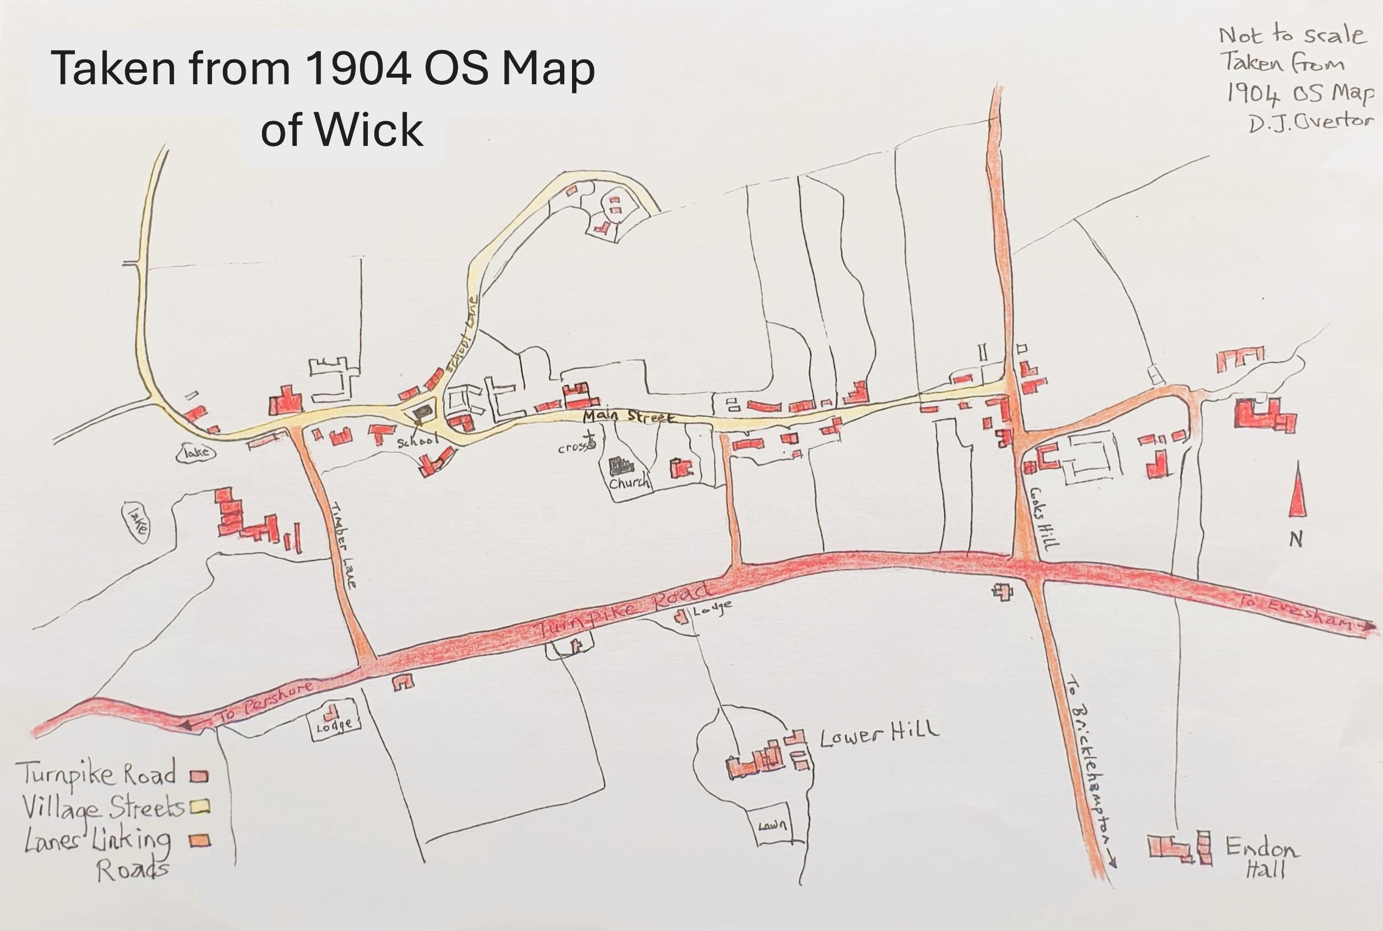
MAP No: 4 – Simplified Map of Wick
This simplified map is to refresh your memory about the layout of the village.
Use your marker pens to draw a circle around the church and school? Can you read the names of the roads?
In Session Two: you will see this map again and it will show your where the houses are that we will investigate.

Slide 12
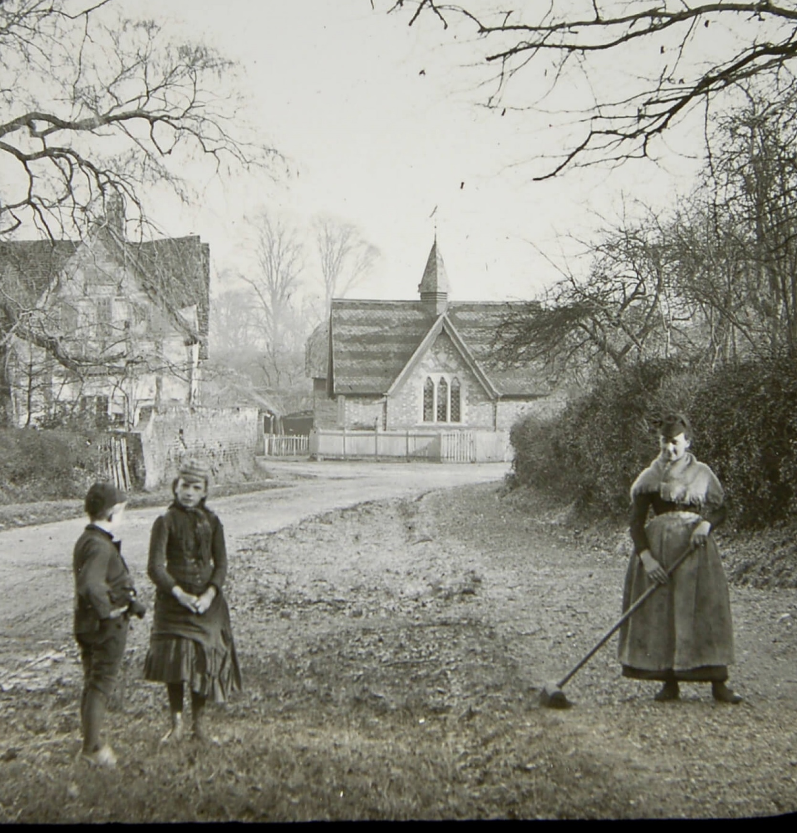
We will now visit the village of Wick, starting with the Victorian school.
Can you see it in the distance? We used this building for our logo!
THE SCHOOL
Photograph of the school and schoolchildren
with a woman sweeping the path.

Slide 13
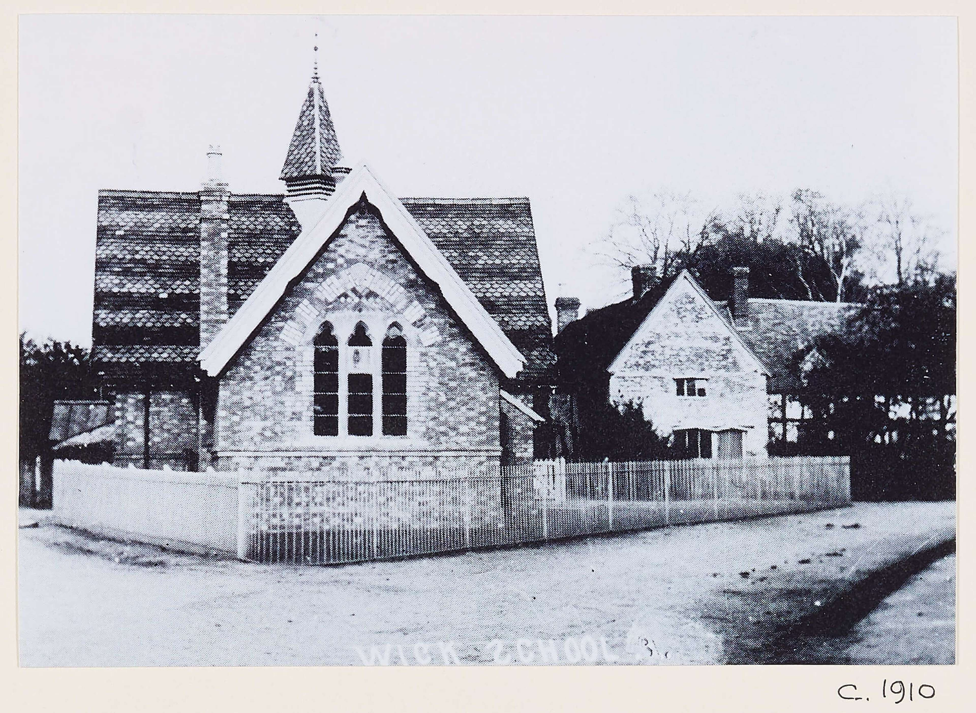
We will find out about Wick School and the village children who went there about 100 years ago
This school was built in the
19th century. There was
a lady headteacher and
only one teaching assistant.
Notice the tiny playground.
What sort of toys do you
think they might have had?
Use the Wick History Trail website, Information Board 1
to find out when it was built and when it was closed.
http://www.wickhistory.co.uk/
Notes:
Built in the 1860s and closed in 1943 – later converted to a house and is still there. Further information on the Wick History Trail website at http://www.wickhistory.co.uk/

Slide 14
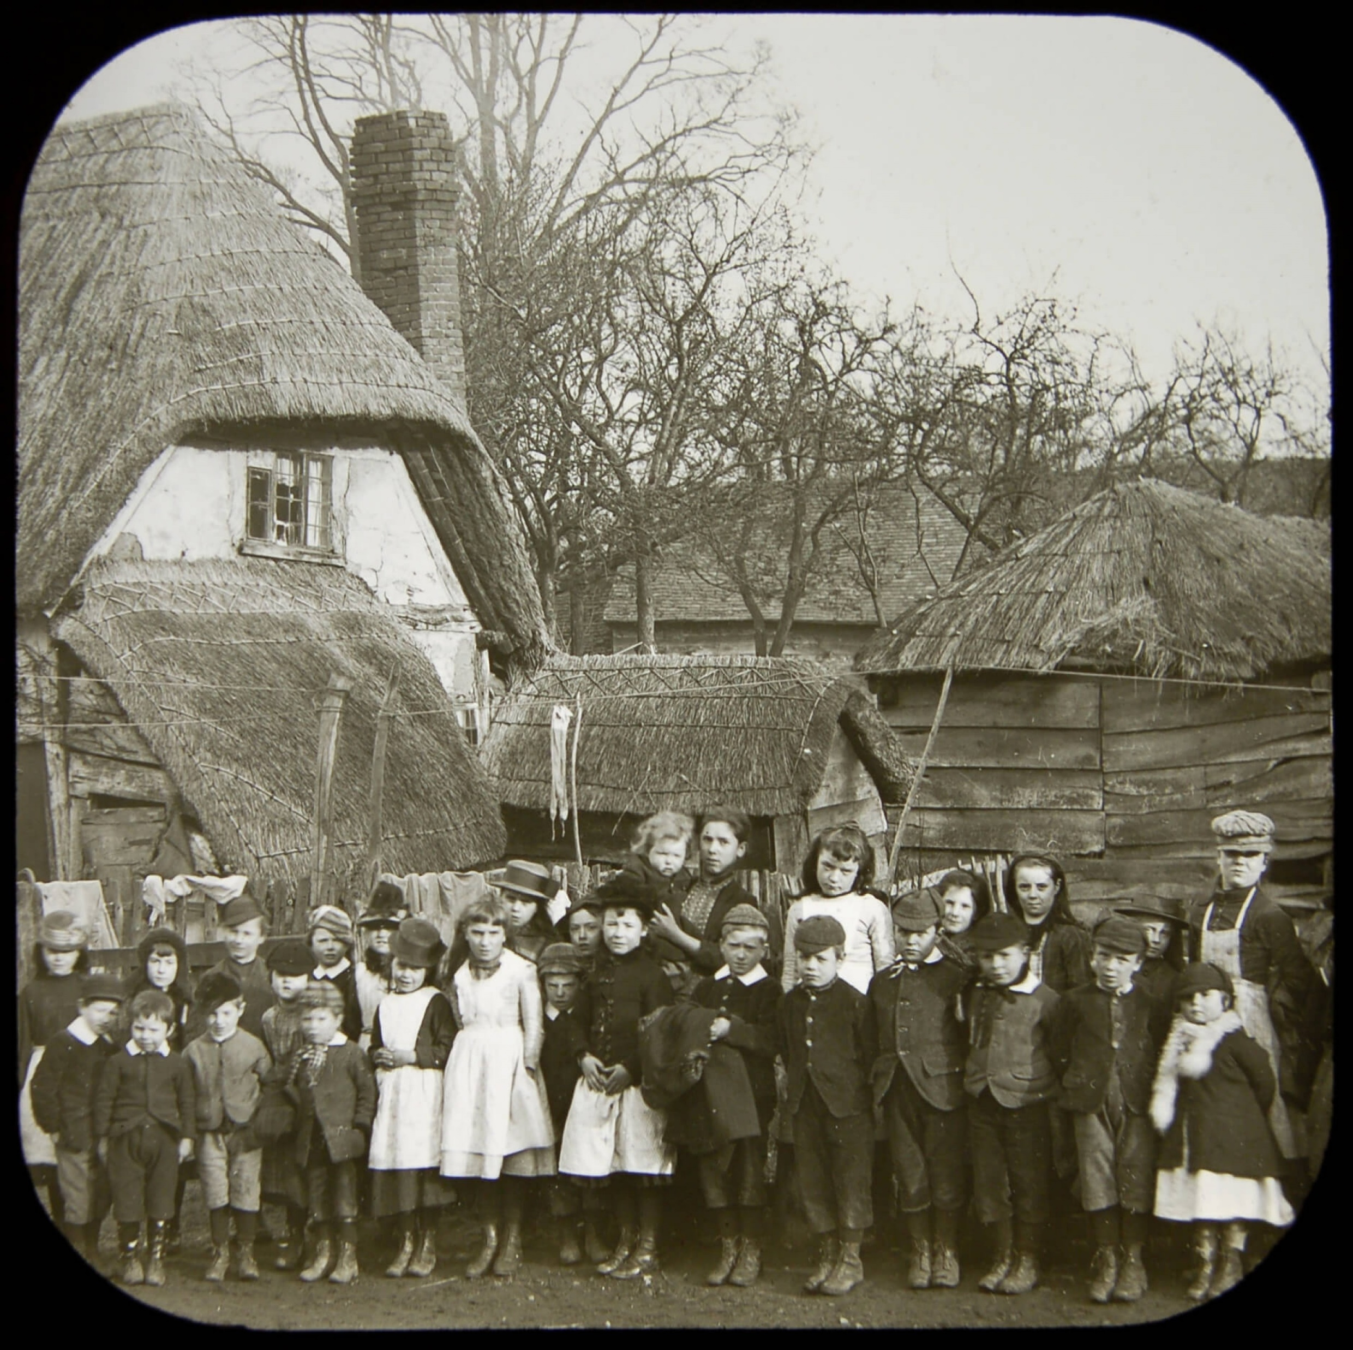
Wick school children in about 1900

Slide 15
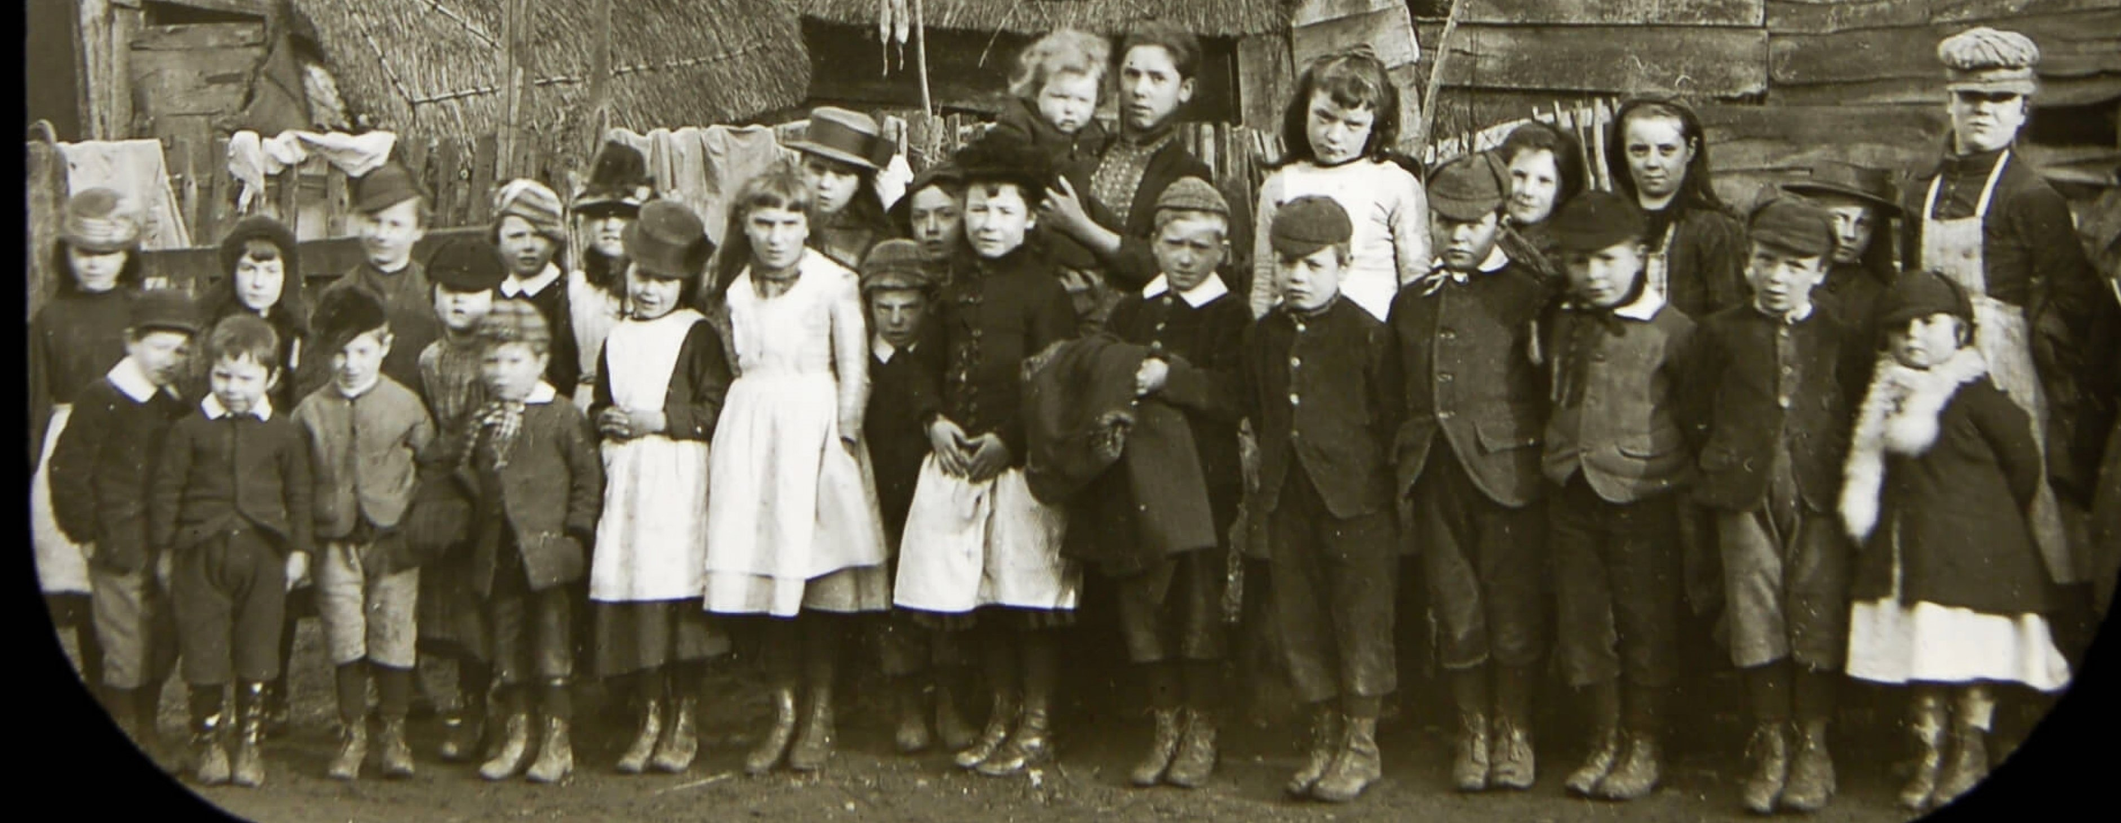
Let’s have a closer look at the Wick Schoolchildren.
Notice their dirty boots. They would have to walk down muddy lanes to get to the village school.
Their boots might be a bit muddy, their jackets look worn out and often covered in straw.
But notice the white collars and pinafores (aprons).
Notes:
There are: Hoods, caps (plain and striped) , boaters (straw hats), baker boy caps, deerstalkers (ones with flaps that could be tied on top or under chin to keep ears warm.

Slide 16
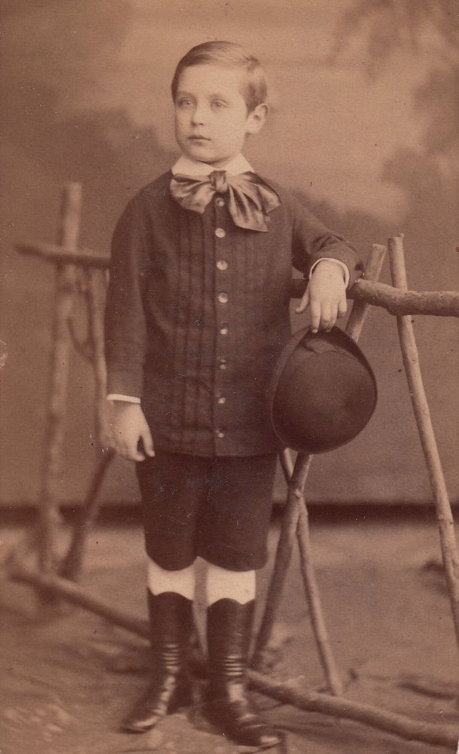
Let’s find out some differences between the children in the Wick school 100 years ago
and schoolchildren today.
What do you notice about their boots and clothes?
How different are they from your shoes and clothes?
Do they have a uniform?
A boy wearing his
Sunday best suit.
2) What sort of different hats can you see?
3) There are more boys than girls at the school, why do you think that was?
Notes:
Compare and contrast with what they are wearing today.
There are: Hoods, caps (plain and stripey), baker boy caps, boaters (straw hats) and deerstalkers (hats which have flaps that can be tied on top or tied under the chin).
It’s very likely that girls were kept home to help their mothers and look after younger children. It was thought more important to educate boys.

Slide 17
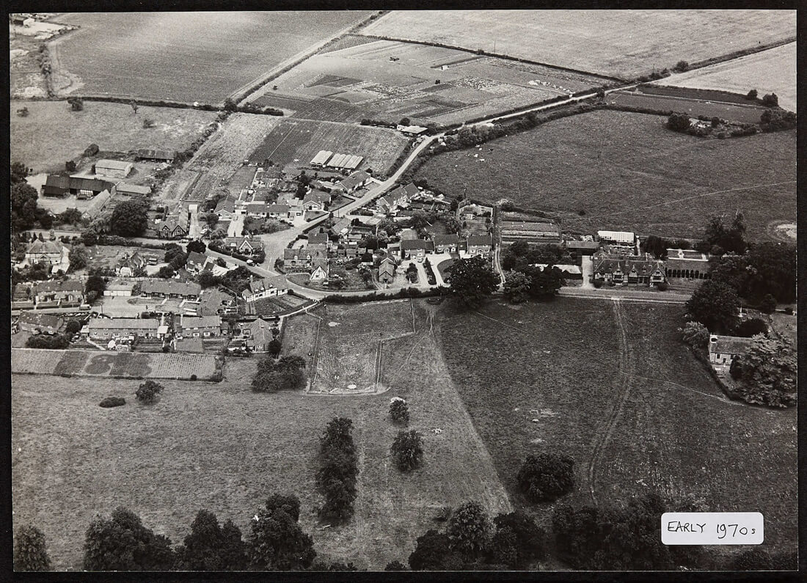
END OF SESSION ONE
Here is an aerial photograph, taken from an aeroplane.
Can you see the school?
Please hand in your magnifying glasses and slates and chalks.
WICK in the early 1970s
© 2025 Wick History. All rights reserved
Notes:
Click mouse to show arrow pointing to school

